Slide 1
Road Transport
Basics

Slide 2


Introduction
What do you associate with road transport?
Notes:
Introduction:
You can either use this slide as a starting point or, alternatively, use the remaining suggestions from the collection of warm-up activities .
Use:
Find out about your pupils‘ attitudes towards and knowledge of road transport. You could proceed in two ways:
Option no. 1 (approx. 5 mins): Give your pupils approx. 1-2 minutes for brainstorming. Afterwards, they can share their thoughts freely without assessment. Group these ideas into categories (e.g. strengths, weaknesses, problems, examples). At the end you can take a photo of the board and make the information digitally available to your pupils. You can always refer back to individual aspects while teaching "road transport/traffic".
Option no. 2 (about 10-15 mins): Hand out two cards to each student (depending on class size), giving them 3 minutes to think about the question at hand and briefly and concisely record their ideas. Then, taking turns, pupils present their thoughts. Put the cards on the board, forming categories (e.g. strengths, weaknesses, problems, examples). At the end, you can photograph the results on the board and make the information available to your pupils. You can always refer back to individual aspects while teaching "road transport/traffic".

Slide 3
Agenda
Basics I:
characteristics, affinity for goods, road network, means of transport
Basics II:
calculation, toll charges in Austria

Slide 4
Characteristics of Road Traffic
strengths
high coverage
door-to-door services
high average speed
flexibility & safety
high capacity utilisation
weaknesses
limited loading capacity
high dependencies
high accident risk
increasing restrictions
Notes:
Strengths:
High degree of coverage: mainly achieved by high density road network.
Door-to-door services: Direct connection to customers as well as increased individual service is made possible. The advantage over other modes of transport is that very few companies have direct connection to rail, waterway, airports or pipelines. Hence, the road is much more flexible.
High average speed: Regardless of external factors (e.g. traffic jams), road traffic has a high average speed not least due to the available road network and good coverage.
Flexibility and security:
Flexibility is created above all by the door-to-door service option and ist quickly realisable availability. The safety aspect lies on the one hand in transport safety devices and in the driver‘s assumption of personal responsibility.
High capacity utilisation:
High capacity utilisation is achieved by appropriated targeted planning or measures in scheduling, among other things.
Limited loading capacity:
Compared to other modes, road transport can transport heavy objects or objects with a larger volume to a limited extent only. As a rule, this requires special permits, which are relatively complex in terms of planning, implementation and costs.
Weaknesses:
High dependencies:
Road transport/traffic is heavily dependent on existing road conditions (e.g. black ice, rain) and the current traffic situation (e.g. traffic jams, bypasses).
Highly accident-prone:
The high risk of accidents results mainly from high traffic density on the road with high proximity between vehicles and that some drivers do not comply with speed limits.
Increasing restrictions:
Increasing political regulations (e.g. extension of driving bans or subsidies for alternative vehicles) or social resistance are hampering the development of road traffic.
Source: Cf. Kummer (2010) p. 86 f.

Slide 5


Road Transport & its Competitors ...
higher mass output
higher security
terminal-to-terminal traffic
less flexibility
high mass output
terminal-to-terminal traffic
longer transport time
higher packaging requirements
Notes:
In comparison to road transport, rail has higher mass efficiency (thus more suitable for heavy or voluminous transport goods) not least due to its larger dimensions, as well as higher safety requirements. Road transport, on the other hand, scores with its door-to-door service for its customers. Like inland navigation, rail transport can only offer terminal-to-terminal transport. Only very few customers have direct rail or waterway access. This in turn, takes road transport to overcome the first and last mile, meaning less flexibility for the customer and the transport operator. A topic often discussed in connection with inland navigation is transport time. A large number of companies do not generally rely on inland navigation due to longer running or transport time and higher packaging requirements. High demands on packaging in particular, are vital for goods protection from existing weather conditions.
Source: Cf. Kummer (2010) p. 89; Cf. Kummer (2010) p. 109.

Slide 6
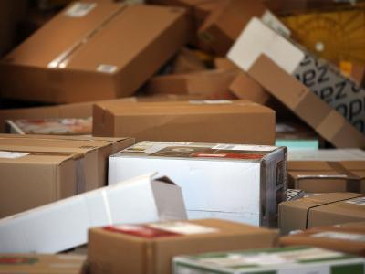
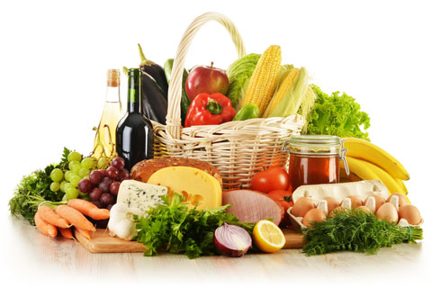

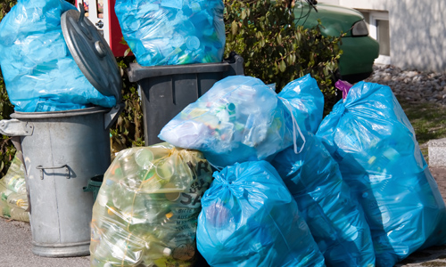
The Road as an Important Factor for Society?
other modes and means of transport
medicine
company
various factors
Notes:
Above all, perishable goods, such as fruit or vegetables, goods with special requirements, such as milk or eggs which need to be kept cool, or the always available daily newspaper depend on road services. Wider analysis also shows that road plays a dominant role in parcel collection, the parcel distribution sector as well as in the waste transport sector, which is already taken for granted. Without it, many products or services (e.g. also in medicine) would not be possible. We should not underestimate the consequences of forgoing the road. Many companies or other modes of transport are dependent on road transport and can no longer carry out most of their activities if it is completely abandoned or banned. The consequences are production bottlenecks, empty shelves in supermarkets, unemployment or declining economic output. Of course, it should be noted in this context that heavy goods vehicles cannot be seen as the panacea of road transport and that alternative options, depending on their design (e.g. cargo bicycles or electric drive), may also bear future potential. The choice always depends on various factors, such as urgency of the transport, convenience or the size of the consignment. This must be assessed accordingly, depending on requirements.
Source: Cf. Die Transporteure (2010) online; Cf. Kummer (2010) p. 86 f, 123.
Images: Bundesministerium für Ernährung und Landwirtschaft (2016) online; DerStandard.at (2016) online; Berg (2016) online; Wodicka (2011) online.

Slide 7
The Road Network ...
Classification according to Kummer
primary road network
secondary road network
tertiary road network
e.g. motorways, expressways
e.g. main roads, country roads
e.g. municipal roads
Category | Net length AT (2011)
primary road network | 2.180 km
secondary road network | 33.660 km
tertiary road network | 88.670 km
Notes:
Source: own presentation based on Kummer (2010) p. 174 f; BMVIT (2012) p. 1.

Slide 8
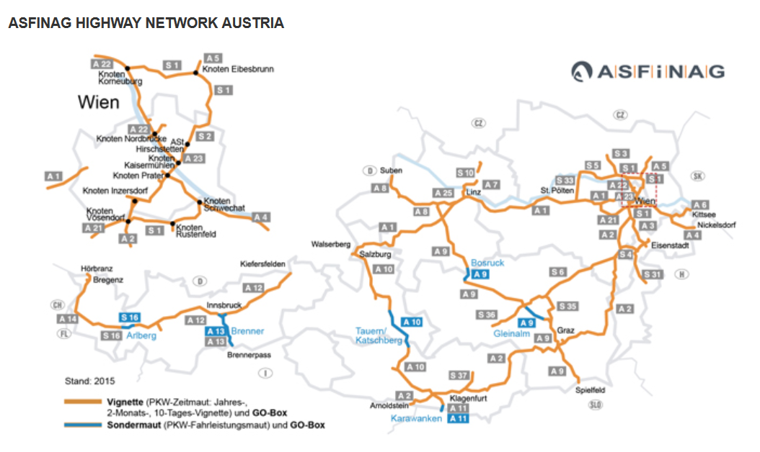
High-level Road Network in Austria
Image: Asfinag
Notes:
A more detailed analysis of the Austrian higher-level road network shows that there are mainly good connections between large cities in Austrian provinces and sufficient options for "fine distribution" through secondary road networks (e.g. main or regional roads). Meeting the growing challenges of the future, ASFINAG has published plans for further road network investments in 2016.
Source: ASFINAG (2016a) online.
Image Source: Asfinag (2019): http://services.asfinag.at/web/trafficdata/poi-highways

Slide 9
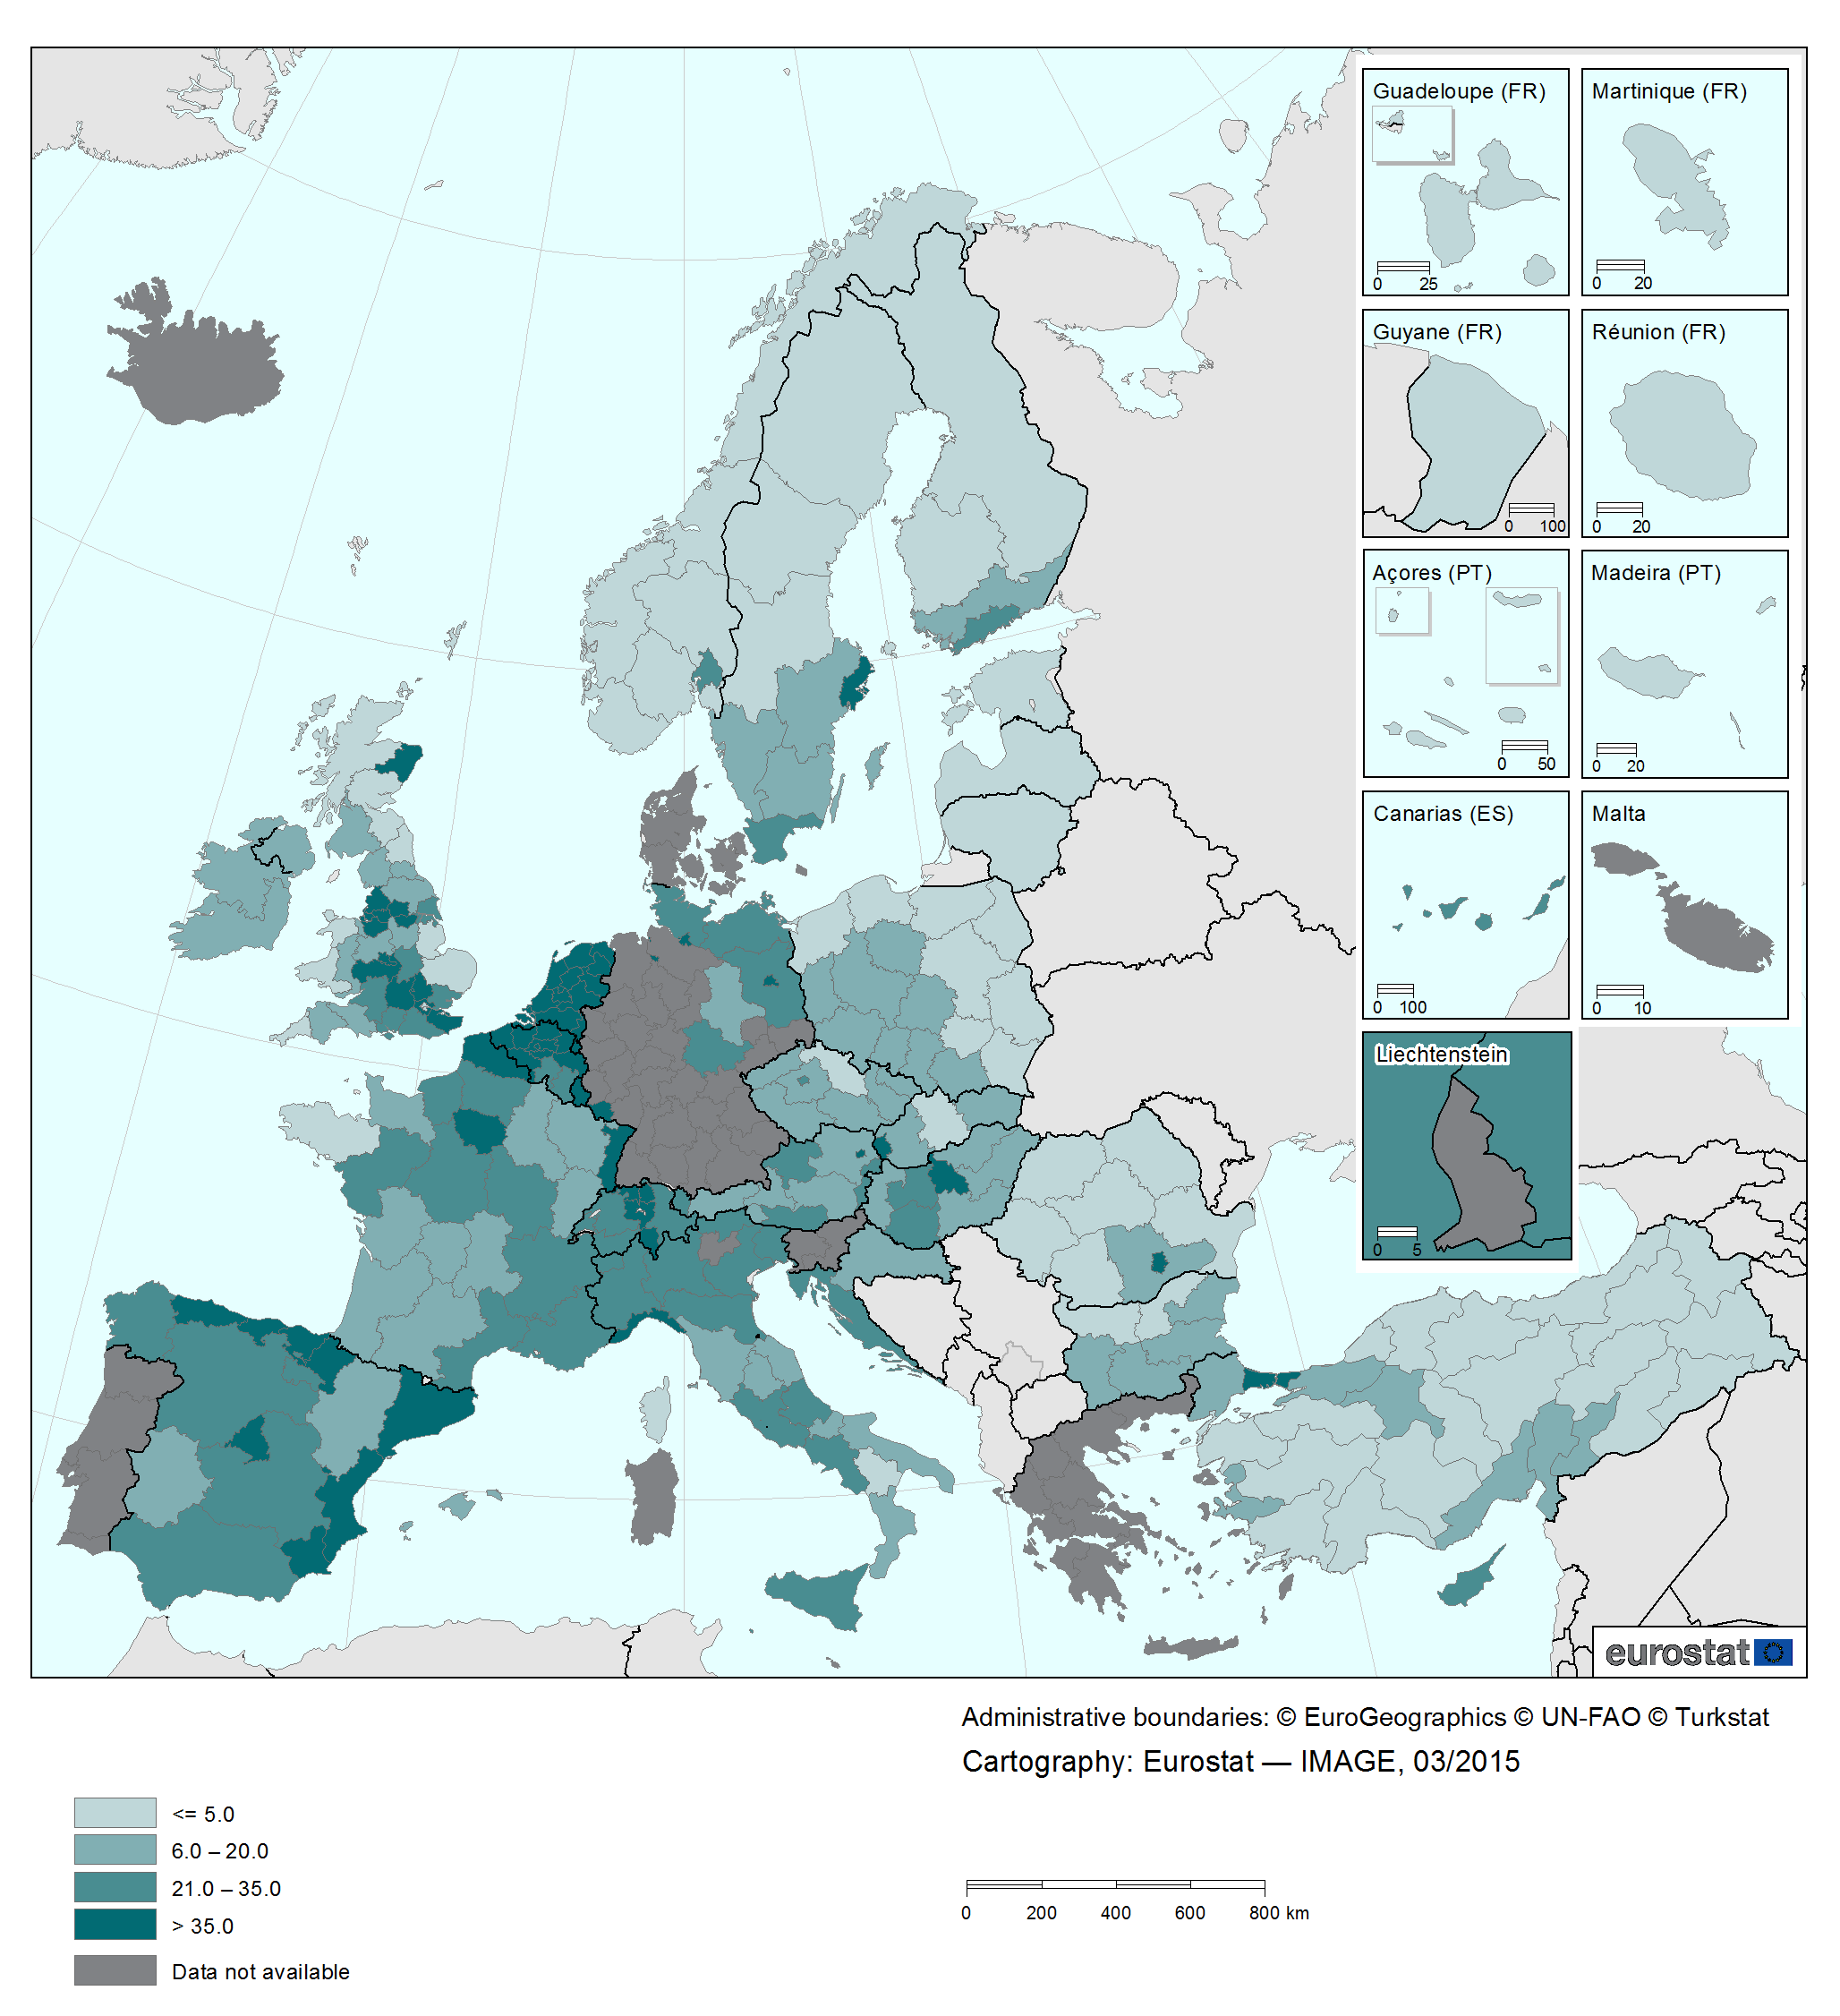
Road Network Density in Europe
Notes:
The European road network boasts predominantly good coverage (combined with area-related higher levels).
Source: Eurostat (2015) online.

Slide 10
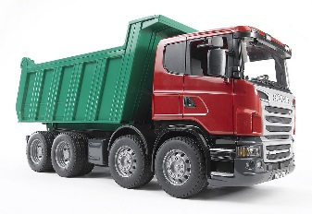

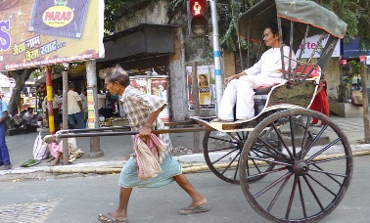
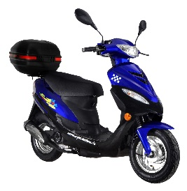
Means of Transport on the Roads
General Classification according to Kummer
multi-lane road vehicles
single-lane road vehicles
with drive
without drive
with drive
without drive
e.g. car, bus, tractor, truck
e.g. trailers (light/heavy), rickshaws, carts
e.g. moped, motorcycle, electric scooter, electric bicycle
e.g. bicycle, scooter, skateboard
Notes:
According to Kummer, means of transport are "technical or natural facilities for transport and transhipment of transport objects (goods, persons or news/messages)". This term should not be confused with the term "mode of transport". This should be seen as a summary of all means of transport using "the same type of transport infrastructure". For easier understanding of the various road-related means of transport , Kummer has drawn up a general classification. First, multi-lane and single-lane (depending on design) road vehicles are distinguished. For the sake of clarity and better attribution of individual means of transport on the road, Kummer once again distinguishes between means of transport on the road with or without drive.
Source: own presentation based on Kummer (2010) p. 194.
Images: Quelle.at (2016) online; Monteux (2012) online; Roller Epple GmbH (2016) online; Roller Derby Skate Corp. (2016) online.

Slide 11
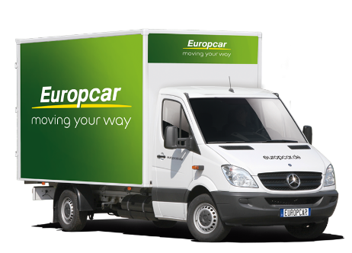
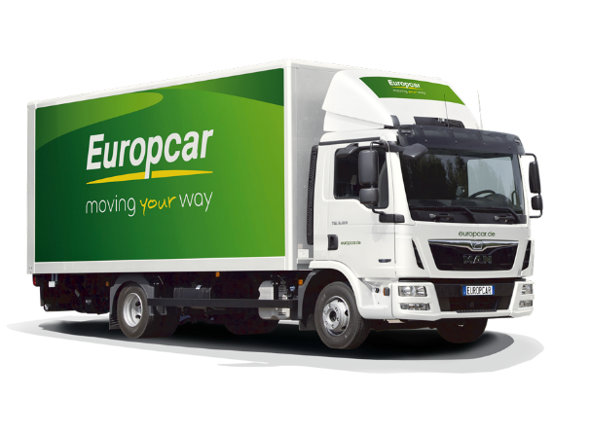
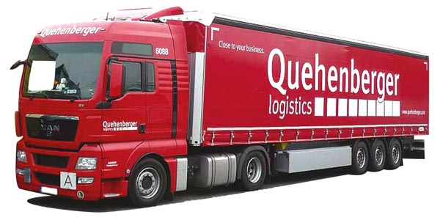
Means of Transport on the Roads
Focus on Goods Vehicles
light goods vehicles
medium-weight goods vehicles
heavy goods vehicles
range of application:
e.g. distribution of parcels, courier services, craft sector, private furniture transport
range of application:
e.g. construction site supply, waste collection, craft sector, distribution of general cargo
range of application:
e.g. connection of large hubs, heavy or long goods
Notes:
For motor vehicles used for road transport, a distinction can be made between light, medium-weight and heavy vehicles according to the different weight categories of Kummer. Light goods vehicles are particularly important for the distribution of parcels, for express and courier services (= conditions where fast delivery or direct delivery of a transport object is necessary), for everyday activities in the craft sector (e.g. a carpenter provides delivery and assembly of furniture for the Mayer family) and also in the private sector (e.g. for the transport of furniture during a move or when moving into a new home). The legal maximum total weight for light goods vehicles is 3.5 tonnes. In addition to light vehicles, our everyday life would be inconceivable without medium-weight goods vehicles. Road transport vehicles with a maximum permissible weight of between 3.5 and 12 tonnes are assigned to this category. Medium-weight goods vehicles are used, for example, to supply construction sites with the necessary resources for further construction progress, to collect waste or to distribute general cargo (e.g. parcels). In everyday life, residents must predominantly put up with heavy goods vehicles, which are often used for urban and interurban deliveries due to their higher load-bearing capacity. For this type of goods vehicle, the maximum legal total weight is between 36 and 60 tonnes (e.g. in Asia or Europe) or between 36 and 125 tonnes (e.g. in Australia, the USA or Canada). In this context, it should be noted that in Austria the maximum legal total weight is 40 tonnes, which may not be exceeded by heavy goods vehicles (except with a corresponding special permit and associated restrictions or requirements). Heavy goods vehicles are particularly suitable for improving the connection between larger hubs in a network (e.g. Post AG's day-to-day business: parcels and mail are taken from regional post offices to mail centres responsible for different Austrian provinces, transhipped between the large hubs and finally distributed at regional level) and, due to the larger dimensions, for transporting heavy or overlong goods (e.g. transport of a fuselage section of an aircraft on the motorway) with the corresponding special permit.
Source: own presentation based on Nagl (2006) cited after Kummer (2010) p. 194.
Images: Baumaschinenbilder.de (2011) online; Europcar (2016a) online; Europcar (2016b) online.

Slide 12
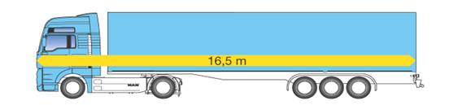
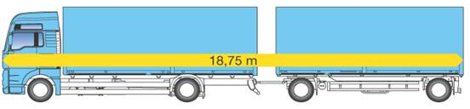
Goods Vehicles
Frequent Truck Types in Daily Use
Facts:
total length: 16.5 m
cargo hold: 90 m3 (= space for 34 Euro pallets)
cargo area: 13.62 / 2.45 / 2.70 m (l/w/h)
articulated lorry
(tractor + trailer/semitrailer)
Facts:
total length: 18.75 m
cargo hold: ~ 94 m3 (= space for 36 Euro pallets)
cargo floor (2x): 7.35 / 2.45 / 2.65 m (l/w/h)
articulated train
(swap bodies)
Notes:
In everyday road transport, the term "articulated lorry" comes up. A semitrailer truck is the combination of a semitrailer tractor (= drive area of the semitrailer truck) and a trailer or semi-trailer (= loading area of the semitrailer truck). A truck of this type has an external length of around 16.5 m and a cargo hold of around 90 m3 (corresponding to a cargo floor of around 34 Euro pallets). The articulated train is longer than the articulated lorry. A link train is a combination of swap bodies (usually with a corresponding motor vehicle) connected like links on a chain (e.g. a necklace) and together form a "train". The total length of this truck type is around 18.75 m, with a total cargo area of around 36 Euro pallets (equivalent to a cargo hold of around 94 m3).
Source: own presentation based on Kummer (2010) pp. 194 f.
Images: Rollerreiner.org (no year) online; Rollerreiner.org (no year) online.

Slide 13
Loading and Transport Units in Road Traffic
cargo
loading devices
e.g. packaging
carriers
e.g. boxes, pallet
transport equipment
e.g. container
means of transport
oil
tank truck
oil
tank container
platoon
drinking glasses
cardboard
pallet
semi-trailer
articulated lorry
food
(e.g. Billa)
cardboard
roll container
motor car
Notes:
The formation of load and transport units plus the use of securing means (e.g. belts, trend walls) are as important as the transport operation. For a good to be carried from starting point (= source) to destination (= sink) a carrier or freight forwarder requires at least one load and a corresponding means of transport. However, not every load can be loaded immediately onto an appropriate means of transport (such as a semitrailer truck for road transport). As a rule, loads require "aids" which, according to Kummer, can be subdivided into loading devices, carriers and transport equipment. It should be noted, however, that not every load must use every "aid". The choice depends on individual requirements and must be applied accordingly.
Source: own presentation based on Kummer (2010) p. 203 ff and in cooperation with Mario Dobrovnik, MSc. (University of Economics and Business Administration Vienna, Institute of Transport Economics and Logistics)

Slide 14
Agenda
Basics I:
characteristics, affinity for goods, road network, means of transport
Basics II:
calculation, toll charges in Austria

Slide 15
Calculation in Road Transport
FIXED costs
VARIABLE costs
staff
fuel
imputed depreciation
tyres
imputed interest
repairs
maintenance, insurance,
tax, administration
toll
daily rate
KM rate
Notes:
Like in any other company, road haulage operators have to calculate their costs in order to sell their services to different customers at a good price. According to cost accounting, both fixed (i.e. activity-independent) and variable (i.e. activity-dependent) costs are part of road transport calculation. The long-term goal is to cover all costs to guarantee further liquidity of the company.
Individual costs are taken into account as kilometre rates (to cover variable costs based on annual average mileage) and daily rates (to cover the pro rata fixed costs broken down by operating days) as part of road transport calculation.
Source: Cf. Kummer (2010) p. 88, 345 ff.

Slide 16
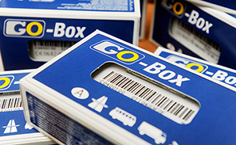
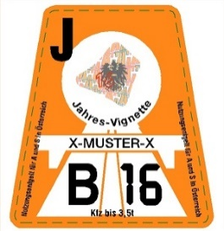
Short Overview
The Austrian Toll System
For the use of Austrian motorways and expressways
Special tolls
"Vignette" system
System "GO Maut" (Engl. toll)
applies to: cars and motor vehicles up to 3.5 t maximum permissible total weight and motorbikes
forms: 10-day, 2-month and yearly vignette
annual vignette costs (from 2016):
€ 86.40 / € 34.40
applies to: trucks, buses and heavy motorhomes
payment depending on usage
tariff breakdown according to axles and emission class
Notes:
Tolls and user charges are collected by ASFINAG (Autobahnen- und Schnellstraßen-Finanzierungs-Aktiengesellschaft).
In the "GO Maut" (Engl. toll) system, toll fees depend on distance travelled. High-level road network use (= primary road network) incurs a corresponding fee. This means that each distance travelled is calculated separately or anew and no one-off amount is charged, as with the "Vignette" system. Individual tariffs depend on the number of axles and the respective emission class. The following applies: the better the emission class, the lower the applied tariff. The distance travelled by the vehicle is recorded by a mobile device, the "GO Box", which must be placed inside the vehicle on the windscreen. The "GO Box" employs microwave technology, a form of data transmission, to communicate with a toll portal (= a kind of thin steel bridge stretched across the road), which forms the basis for toll calculation. The advantage of the Austrian toll system is that the toll debit is not influenced by the lane used or the selected speed. This principle is also known in science as the "Multilane-Free-Flow" system.
It should be noted that special fares apply on certain routes in Austria (e.g. Pyhrn or Tauern motorways), added to the tolls already paid under the "Vignette" or "GO Maut" system.
Source: Cf. ASFINAG (2016b) online; Cf. ASFINAG (2017) online; Cf. ASFINAG (2016c) online.

Slide 17
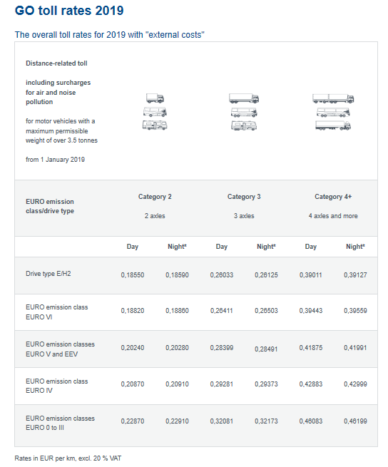
Tariff Overview - "GO Maut" System
Notes:
Image: ASFINAG (2019): https://www.go-maut.at/portal/faces/pages/common/portal.xhtml

Slide 18

Additional Information
We hope our PowerPoint presentation meets your requirements!
You are welcome to adapt this presentation according to your wishes and requirements and to use it for your lessons/lectures.
We are happy to receive your questions or feedback at reroad@fh-vie.ac.at .
Further PowerPoint slides and teaching materials at
http://www.retrans.at/de/

