Slide 1
Traffic Telematics

Slide 2
How to work with this learning material
Power Point
  The following power point presents TRAFFIC TELEMATICS. The slides are shortly described in the notes below, they also provide the link to the source if you need further information.
Reader
  In addition to the power point presentation, you can also use the reader provided on our platform. It’s more detailed and can be used as a script for your lessons.
Links
  You can find the sources of our presentation and reader in the link section of the relevant bundled teaching material.
Videos
    There are different videos used as sources in this presentation. You can find these videos separately in the corresponding section of the relevant bundled teaching material.

Slide 3


Introduction
What do you associate with traffic telematics?
Notes:
Introduction:
You can either use this slide as a starting point or, alternatively, use the remaining suggestions from the collection of warm-up activities .
Use:
Find out about your pupils‘ attitudes towards and knowledge of traffic telematics. You could proceed in two ways:
Option no. 1 (approx. 5 mins): Give your pupils approx. 1-2 minutes for brainstorming. Afterwards, they can share their thoughts freely without assessment. Group these ideas into categories (e.g. strengths, weaknesses, problems, examples). At the end you can take a photo of the board and make the information digitally available to your pupils. You can always refer back to individual aspects while teaching „traffic telematics".
Option no. 2 (about 10-15 mins): Hand out two cards to each student (depending on class size), giving them 3 minutes to think about the question at hand and briefly and concisely record their ideas. Then, taking turns, pupils present their thoughts. Put the cards on the board, forming categories (e.g. strengths, weaknesses, problems, examples). At the end, you can photograph the results on the board and make the information available to your pupils. You can always refer back to individual aspects while teaching „traffic telematics".

Slide 4
Agenda
Basics:
Definition, Development, Goals
Traffic Telematics Systems:
Management of motorised individual traffic
Public Transport Management
Fleet and Freight management

Slide 5
The Concept of Telematics
Telecommunications
Informatics
Automation
Notes:
Telematics is an artificial word and derives from the terms automation, telecommunications and informatics. The task of automation is the acquisition of data by sensors, that of telecommunications is the transmission of data between fixed and/or mobile devices. Information technology processes the information and presents it in appropriate formats.
Traffic telematics is the use of telematics in traffic. It deals with the acquisition, transmission, processing and presentation of data (for example: position, temperature, speed, humidity, acceleration). Its basic objectives are to improve transport use and infrastructure capacity. Transport telematics also supports coordination within or between modes of transport such as road, rail, sea and air.
Source:
Cf. Federal Ministry of Transport, Innovation and Technology (no year), online
See Kummer (2010), p. 51 ff.

Slide 6
Development of Traffic Telematics
1960s
GPS
1978
term „telematics“
1983
GPS – civilian application
1990s
safety equipment in vehicles (e.g. airbags), first vehicle location systems
2000er
real-time information, mobile apps
Notes:
In the mid-1960s, a global positioning system, the GPS, was developed for the first time. Originally it was a system of the US Navy to be able to locate submarines with nuclear weapons during the Cold War and thus the origin of what is now understood by telematics. In 1978, the term telematics was first used by the French government in a report on the computerisation of society. Originally, GPS technology was not intended for use by the general public. However, a plane crash in 1983, in which 269 people lost their lives, gave the impetus for civilian application.
In the 1990s, safety equipment in vehicles was improved and, for example, airbags or daytime running lights were prescribed. In 1992, the EU's DRIVE programme was terminated, and an agreement was signed to promote the further development of telematics. The EU wanted to expand its competitiveness through superior transport and logistics networks. The first vehicle location systems were also invented. The hardware in vehicles was connected to the software installed on computers via local servers.
In the 2000s a number of further information became available. This includes real-time information, for example on the traffic situation, traffic jams, construction sites and radar cameras, as well as mobile apps designed to support the driver. Smartphone apps are now also available to help fleet managers monitor their vehicles from a distance. Furthermore, they are intended to support drivers in routine tasks, such as recording data in a driver's logbook.
Telematics systems provide fleet managers with information about the driving behaviour of drivers and can thus ensure that the company's fuel, maintenance and insurance costs can be reduced. Communication between office staff and drivers on the road is facilitated by telematics and leads to better cooperation. Built-in devices in vehicles provide an overview of the performance of the fleet. This allows the use and condition of the vehicles as well as their driving behaviour to be monitored and analysed, thus reducing operating costs.
Source: Cf. TomTom (no year), p. 5ff.

Slide 7
Objectives of Telematics Applications
increasing traffic safety
improvement of services for road users
contribution to environmental compatibility
networking of transport modes
improvement of economic efficiency
Objectives
Notes:
Depending on application, different objectives are pursued:
increasing traffic safety through facilities in vehicles and on the road, through targeted traffic information, etc.
improvement of economic efficiency
increasing productivity and capacity by making better use of existing infrastructure in all modes of transport
networking of transport modes to exploit the system advantages accordingly
contribution to environmental compatibility through traffic avoidance and reduction by means of modern control technology etc.
improvement of services for road users, e.g. through up-to-date information across all transport modes
Source: See Ausserer, K. et al. (2006) p. 6

Slide 8
Opportunities for road freight transport
facilitated transport planning
facilitated order processing
facilitated fleet management
tracking of shipments
vehicle monitoring
Linking transport modes, e.g. rail and road
Opportunities
Notes:
The opportunities for road freight transport include the following:
facilitated transport planning (e.g. avoidance of empty runs)
facilitated order processing (e.g. increasing flexibility, avoiding disruptions, increasing delivery reliability)
facilitated fleet management
tracking of shipments which promotes customer loyalty
vehicle monitoring, e.g. to reduce both fuel consumption and environmental impact
Linking transport modes, e.g. rail and road
Source: See Berg/Rolf (no year) p. 2 ff; see Andres (2003) p. 3 ff.

Slide 9
Reasons for using traffic telematics
A company's fuel, maintenance and insurance costs can be reduced
Communication between office staff and drivers on the road is facilitated
Provides an overview of the performance of the fleet
Allows autonomous driving
Reasons for use
Notes:
Telematics systems provide fleet managers with information about the driving behaviour of drivers and can thus ensure that the company's fuel, maintenance and insurance costs can be reduced. Communication between office staff and drivers on the road is facilitated by telematics and leads to better cooperation. Built-in devices in vehicles provide an overview of the performance of the fleet. This allows the use and condition of the vehicles as well as their driving behaviour to be monitored and analysed, thus reducing operating costs.
Source: Cf. TomTom (o.J. ), p. 5ff.

Slide 10
Agenda
Basics:
Definition, Development, Goals
Traffic Telematics Systems:
Management of motorised individual traffic
Public Transport Management
Fleet and Freight management

Slide 11
Classification of Traffic Telematics Systems into Application Areas
Management of motorised individual traffic
collective traffic influence
individual traffic control
Management of public transport
operations control systems
information and services
fee collection
fee collection
Fleet and freight management
traffic control
fee collection
traffic information and logistics
Notes:
The possible applications of traffic telematics are very diverse and widely spread. In principle, the use of telematics in transport is of an additive and integrative nature, i.e. no existing system is replaced, but should support the implementation of sustainable transport strategies. In the following figure traffic telematics systems are classified into application areas.
See Ausserer, K. et al. (2006) p. 12.
1. Management of motorised individual traffic
Collective influences on traffic are recognisable for all road users and in some cases also binding. Regulations and information are intended to control traffic depending on current traffic conditions and influence driving behaviour in a desired direction. Examples are traffic control systems (route control systems, network control systems, traffic junction/node control systems), warning systems (fog warning systems), automatic traffic controls (section control), or parking guidance systems.
Individual traffic control systems can be divided into two groups: information systems and assistance systems. Information systems primarily have a warning or informational character. These include navigation systems, travel and traffic information services as well as comfort and infotainment services. Assistance systems mainly serve the safety and the relief of the driver. The degree of intervention can be not only informative, recommending and warning, but also automatically intervenes in the driving action.
Fees for motorised private transport refer to road tolls or parking fees, both already electronically billed. Such billing systems collect fees quickly and smoothly while being convenient for the user.
See Ausserer, K. et al. (2006) p. 17ff.
See Ausserer, K. et al. (2006) p. 20ff.
See Ausserer, K. et al. (2006) p. 25.
2. Public Transport Management
In public transport, many telematic devices are often invisible and cannot be recognized as such. They are perceived by the passenger, for example, only through an improvement in comfort (e.g. denser intervals, shorter waiting times). In contrast to individual telematics applications in motorised private transport, the new technologies in public transport in principle benefit all road users equally.
Transport telematics systems for public transport management can basically be divided into three groups:
operations control systems, e.g. disruption management, dynamic passenger information, automatic traffic light control
iInformation services, e.g. electronic timetable information systems (internet, mobile phone)
Charging, e.g. SMS ticket, online ticket, electronic ticket
See Ausserer, K. et al. (2006) p. 26.
3. Fleet and Freight Management
Telematics applications for fleet and freight management increase traffic safety, optimise goods delivery and, above all, reduce traffic congestion. This happens by shifting freight traffic to rail on the one hand, and on the other by shorter waiting times for road freight traffic, by avoiding congestion (e.g. through targeted traffic information and better route selection) or by improved logistics.
Traffic control is achieved, for example, by dosing systems (avoiding congestion in tunnels) or reservation systems (booking a tunnel passage in advance).
Many European countries levy HGV (heavy goods vehicle) tolls on trucks. In Austria, a mileage-based toll on motorways and expressways applies to all vehicles over 3.5 tonnes maximum permissible weight (lorries, buses and heavy motor caravans). Toll collection takes place via microwave technology (DRSC - Dedicated Short-Range Communication) across several lanes without reducing vehicle speed. Vehicles liable for tolls require an on-board unit, the so-called "GO-Box" (see below). Vehicle owners can choose whether they pay tolls before or retroactively.
With regard to traffic information, services similar to motorised private transport can be used, seeing the tracing and tracking system as a customer service. Consignments can be tracked according to criteria like the consignment number. In addition, there are various telematic systems in fleet management which monitor vehicles to locate problems when difficulties arise.
See Ausserer, K. et al. (2006) p. 34.
Cf. Asfinag (2019b), online; Cf. Cerwenka et al. (2007), p. 108
See Ausserer, K. et al. (2006) p. 35ff.

Slide 12
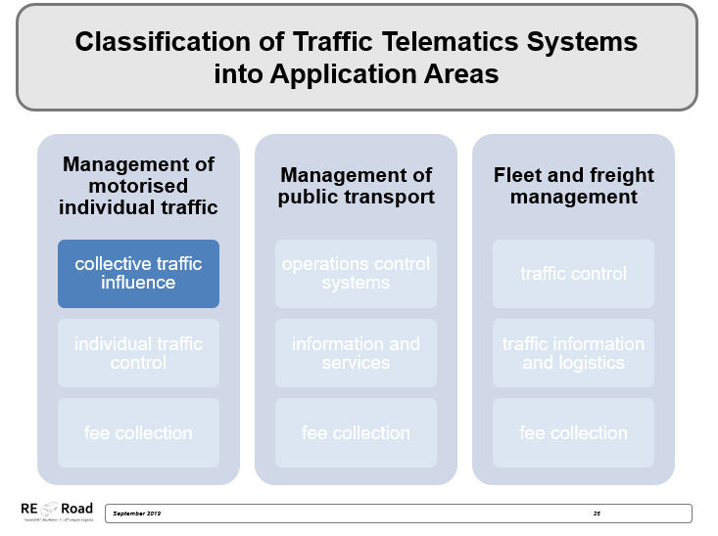
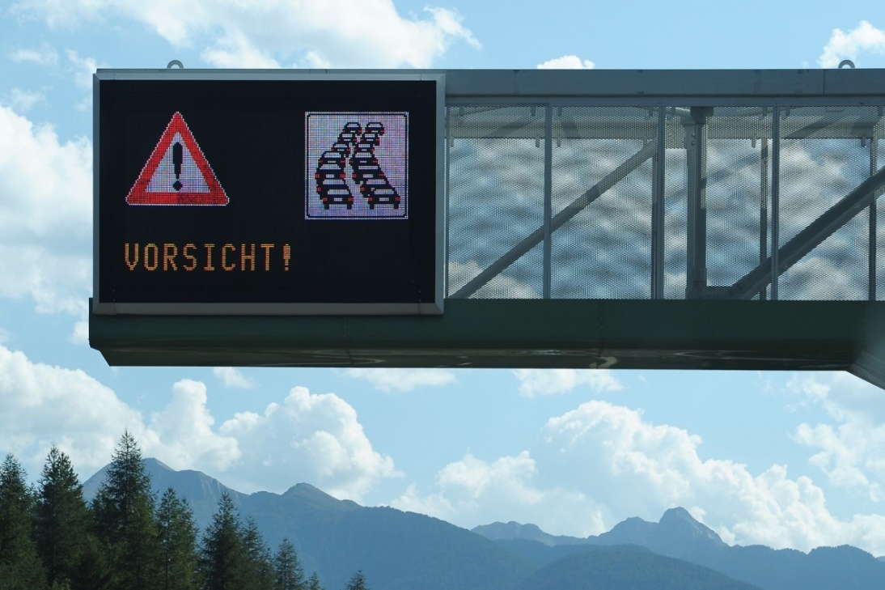
Traffic Control Systems
reduction of traffic jam probability, reduction of accident frequency and severity, reduction of noise and pollutant emissions
information generation for use in navigation systems, route planning programmes and fleet management systems
Notes:
Traffic influencing is based on an integrated control and information system, which controls traffic depending on current conditions and influences driving behaviour. They are recognisable to all road users and in some cases are also authoritative. Traffic conditions are automatically recorded and forecast resulting in recommendations, warnings, restrictions or orders.
Advantages of traffic control systems in road traffic:
reduction of traffic jam probability by stabilising the traffic flow
increase of infrastructure capacity by opening hard shoulders
reduction of accident frequency and severity
reduction of noise and pollutant emissions
information generation for use in navigation systems, route planning programmes and fleet management systems
See Ausserer, K. et al. (2006) p. 13.
Cf. Kummer (2010), p. 52 f.
Bild: pixabay

Slide 13
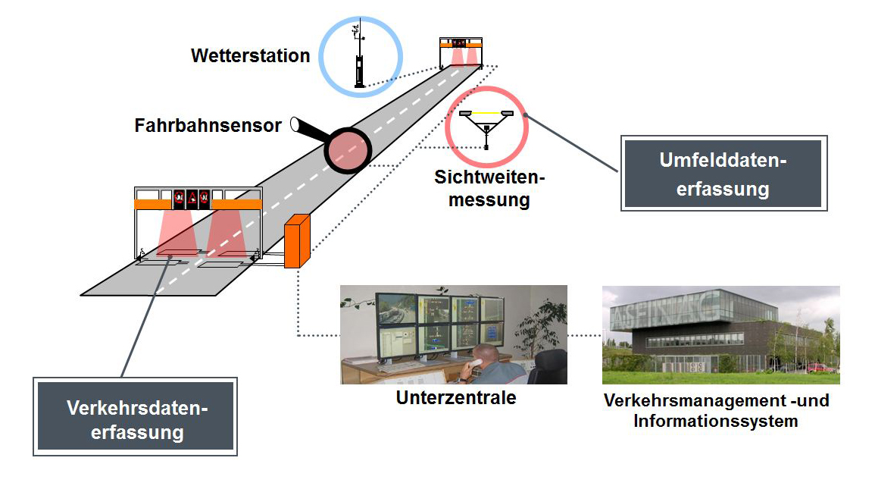
Functional Diagram of a Traffic Control System
Weather station
Road sensor
environmental data collection
visibility measurement
traffic data acquisition
subcentre
Traffic management and information system
Images: ASFINAG
Notes:
The sensors record environmental and traffic data such as the traffic volume, speeds or weather conditions (wetness, visual impairments) along the motorway. Depending on this data, speed limits and/or warnings are switched automatically. In addition, there are also operators who can use the traffic control system to display speed limits, warnings or lane assignments in the event of events such as accidents, breakdowns and lost parts on the road.
Types of traffic control systems:
Route control system: displays speed limits, overtaking bans, lane assignments and warnings based on prevailing conditions (accident, traffic, congestion, construction site, weather). They control the speed in the motorway network. Traffic data and weather data are continuously recorded via detectors and the information is displayed with variable traffic signs via a control logic. In addition, the data obtained is used for traffic radio.
Network control systems: provide information on events such as diversions and closures and can suggest alternative routes. A distinction is made between additive and substitutive rerouting systems (variable message signs to advise drivers of alternative routes). In the case of additive rerouting, the road user is only advised to switch to the detour route by means of a diversion arrow. In substitutive rerouting, the goals and arrows of normal signposting are exchanged.
Junction control systems: traffic flows at motorway junctions can be controlled traffic-dependently, e.g. by temporarily blocking the right-hand lane of a continuous lane in order to make the approach for a strong incoming flow easier. A special type of adjacent junction influencing systems are inflow control systems. During peak traffic periods, cars are only let onto the motorway "drop by drop" by traffic lights at the access roads. This access metering regulates the traffic volume on the motorway and keeps it below the congestion limit.
Sources: See. Asfinag (o.J.), online; See Ausserer, K. et al (2006), S. 13f.

Slide 14
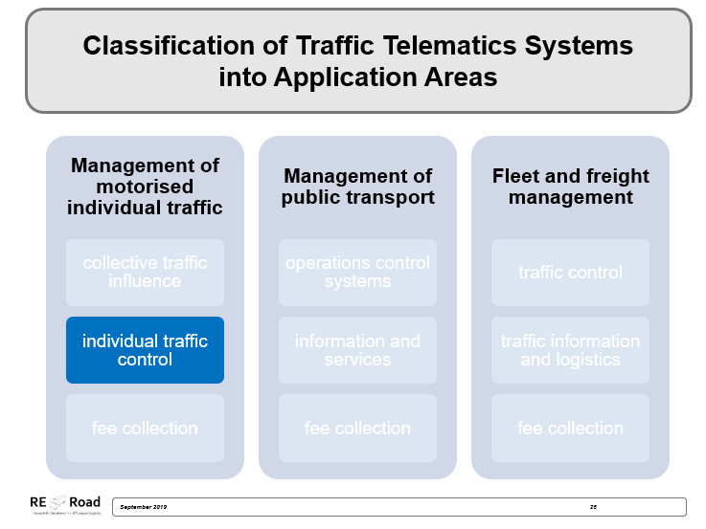
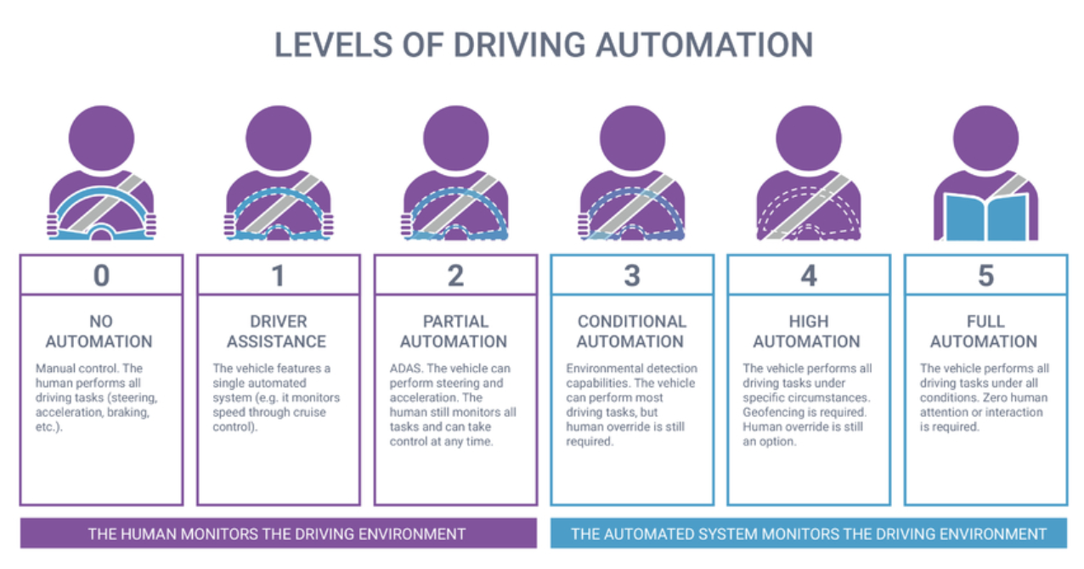
Autonomous Driving
Image: Synopsis.com
Notes:
Autonomous driving means independent, targeted driving of a vehicle in real traffic, without driver intervention. The vehicle initially obtains its input data from visual information sources that are also available to the driver. In the preliminary stages of autonomous driving, the technology supports human perception by providing information that enables the driver to make a safe decision and react quickly. However, if the reaction of the vehicle takes place independently via algorithms and associated reactions of the vehicle without the active influence of the driver, this is referred to as autonomous driving.
The International Society of Automobile Engineers (SAE) has defined six levels of autonomous driving. The first three gradations describe the area in which the human driver has control over the vehicle. Levels 3 to 5 then subdivide what is understood as autonomous driving. Here the machine takes over most of the supervision.
A distinction is made between the different gradations below:
Level 0 - no automation: This is classic driving. Stage 0 describes a vehicle in which the driver performs all control tasks, i.e. steers, accelerates and brakes herself/himself. At no time is the driver supported by an assistance system.
Stage 1 - Driver assistance: At Stage 1, the vehicle has systems which, thanks to information collected from outside, can take over parts of the "Dynamic Driving Task" in certain driving modes. An example of this would be the emergency brake assistant, which assumes the partial task of braking in a hazard context but leaves all other vehicle control tasks to the driver.
Stage 2 - Partial automation: At this stage, the vehicle can perform several tasks simultaneously. Like a traffic jam pilot, for example, who recognizes the road boundary as well as the speed and distance of the person in front. On the basis of this information, the system is able to accelerate, brake and steer the vehicle within a certain driving mode (here: the motorway). However, taking over these aspects of the dynamic driving task only works within a defined frame, for example only up to 60 km/h. The driver must keep an eye on the surroundings and, if higher speeds are possible again, take the wheel.
Level 3 - Conditional automation: At level three, the vehicle itself takes over all the tasks of the highest dynamic driving task" and, depending on the environmental situation, also carries out lane changes, for example. At this level of automation, however, the assumption applies that the human driver is ready to take the wheel at any time and thus react appropriately to a request to intervene. Furthermore, the level 3 system does not work in all driving modes.
Level 4 - High automation: The main difference to level 3 is that the system executes all tasks of the dynamic driving task even if the driver does not react to a request to intervene. In an emergency, the system literally relies on itself and follows a predefined strategy, such as braking to a standstill and sending an emergency signal.
Stage 5 - Full automation: Finally, all the tasks of the dynamic driving task are assumed by the system in all driving modes but can be controlled by a human being. In this stage, the vehicle moves purposefully and independently from A to B under all conditions.
Sources:
Cf. Randelhoff, M. (2017), online.
See Lang (2017), online.
See Lang (2017), online.
See BMVIT (2019), online.
Source-Image: See Synopsis.com (2019), online

Slide 15
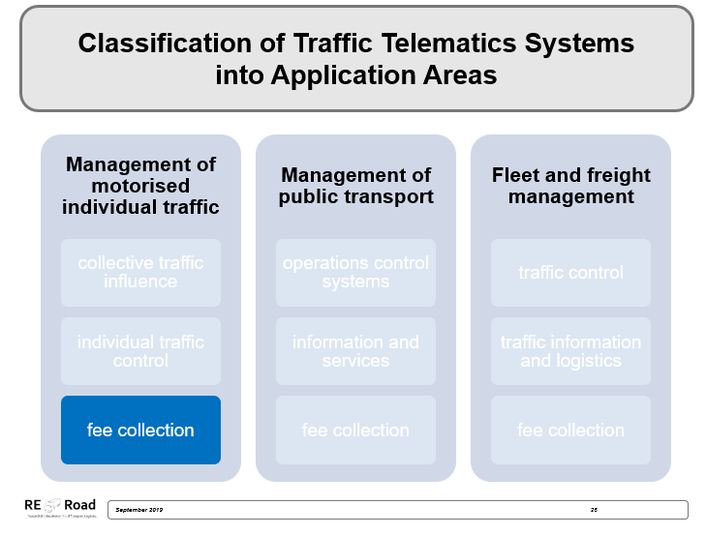

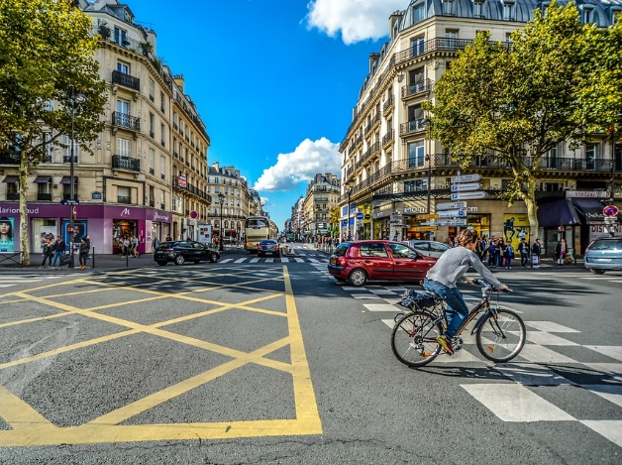
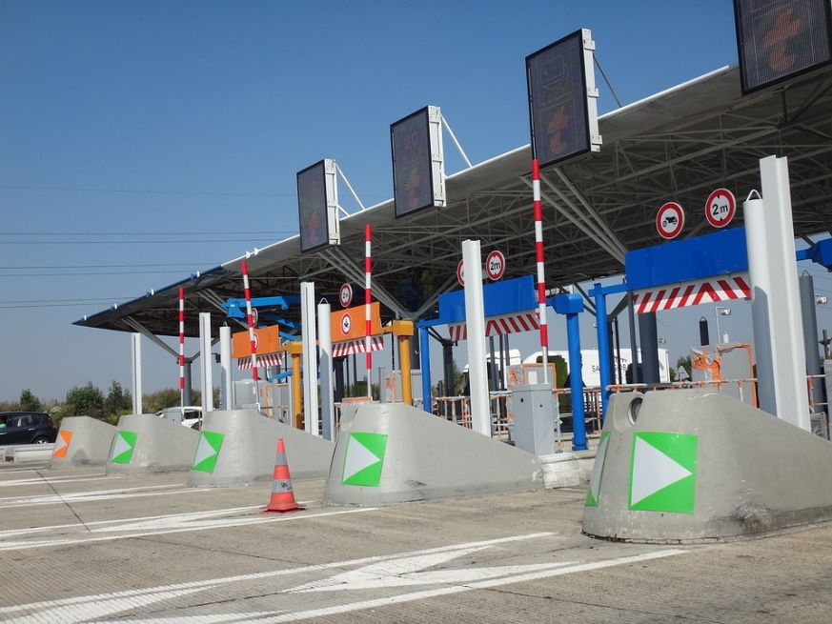

City Toll – a Congestion Charge for Road Traffic
Notes:
The main aim of a city toll is to reduce congestion in conurbations. An increase in usage costs leads to reduced car use and a shift to alternative means of transport. As a result, congestion, the stress on the environment and city dwellers are reduced. As a positive side effect, revenues can be generated for road construction projects or the expansion of public transport.
One of the best-known city toll projects in Europe is the congestion charge in London. For 11.50 pounds a day on weekdays between 7 and 18 o'clock you can make as many trips as you like. In Italy some cities have so-called "Zona traffico limitato" (limited traffic zone) in order to limit traffic and reduce particulate air pollution. In Florence, Genoa, Rome and Pisa, for example, parts of the city are closed to all traffic or only at certain times. In Milan and Bologna, you pay to enter certain zones. In Norway, the city toll partly finances the expansion of the road network by levying a user charge for the route until the costs of construction are covered. In Sweden there are chargeable zones in Stockholm and Gothenburg from Monday to Friday depending on the time of day. The revenue is also used for road construction and for the safety of non-motorised road users.
Sources: See Sammer (2012), p. 480.; Cf. Großmann, J. (2015), online
Source Image: pixabay

Slide 16
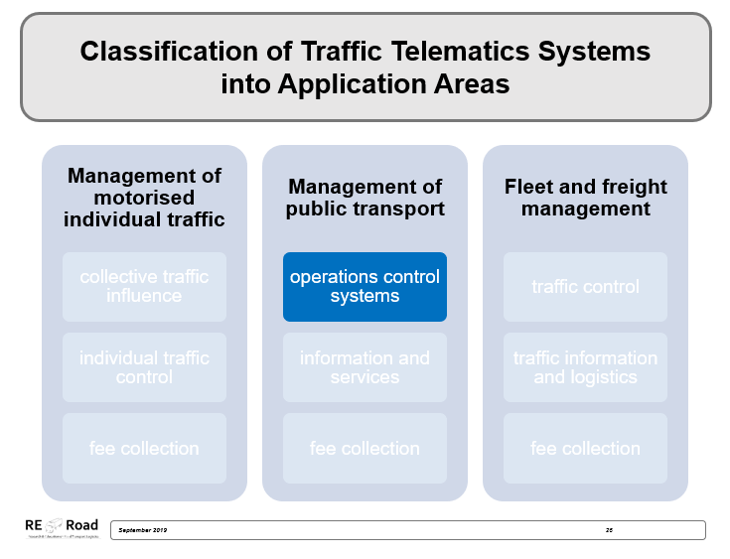
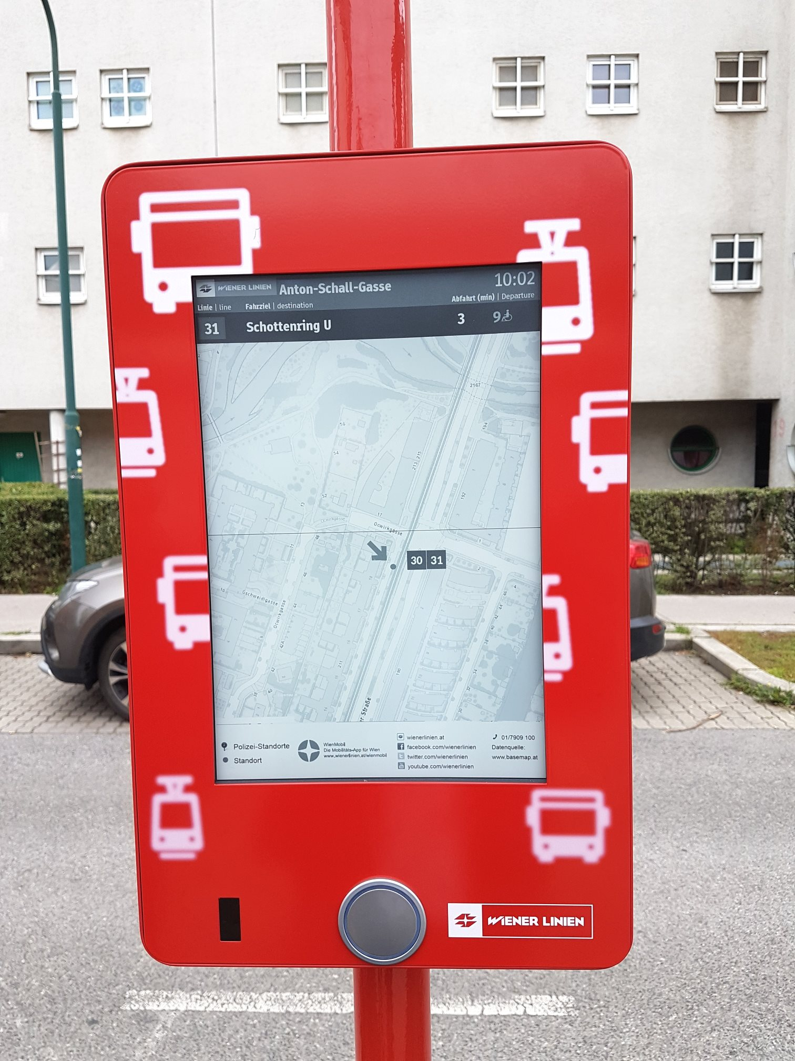
Dynamic Passenger Information next:urban technologies
waiting times
delays
current position of the vehicles
reading function for blind and visually impaired people
light on the display
Bild: next:urban technologies
Notes:
The dynamic passenger information of "next:urban technologies" provides real-time information at stops and can therefore automatically display waiting times until the next departure, delays and the current position of the vehicles. Furthermore, there is a reading function for blind and visually impaired people and, for the night or if the ward is poorly illuminated, more light on the display.
Source: See Forschungsinformationssystem (2019), online; next:urban technologies GmbH (o.J.), online
Source Image: next:urban technologies GmbH (o.J.), online

Slide 17
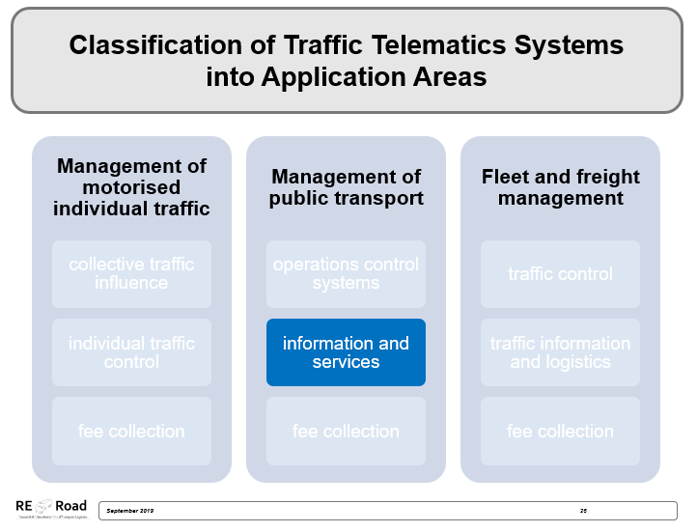
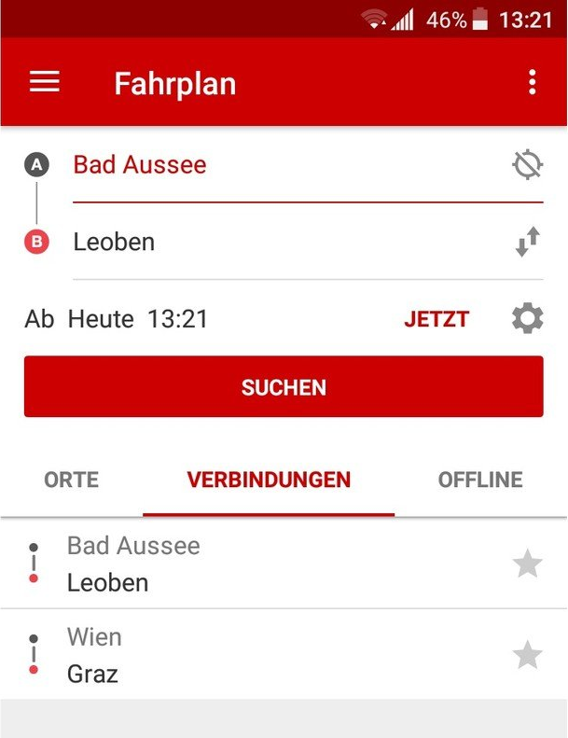
ÖBB SCOTTY App
SCOTTY can access the timetables of all public transport companies in Austria
seamless itinerary planning
area maps can be downloaded to the mobile device
Bookmark frequently travelled routes as favourites
real-time information on individual trains
information on disruptions
Notes:
The "SCOTTY" app is Austrian Rail (ÖBB) timetable information for all popular smartphones and tablets.
SCOTTY can access the timetables of all public transport companies in Austria. This enables seamless itinerary planning. The area maps can be downloaded to the mobile device and are available offline. In addition, you can bookmark frequently used stations or frequently travelled routes as favourites. Via the Internet, all information such as departure and arrival times or delays are recorded in real time and can be displayed directly. The train radar can display on a map all ÖBB trains, or just special train types, in the Austrian rail network and provide real-time information on individual trains. In addition, all deviations or faults in the rail network can be queried via information on disruptions.
Sources: Cf. ÖBB (no year), online; ÖBB Personenverkehr AG (no year), online; image source: Steirische Tourismus GmbH (no year), online

Slide 18
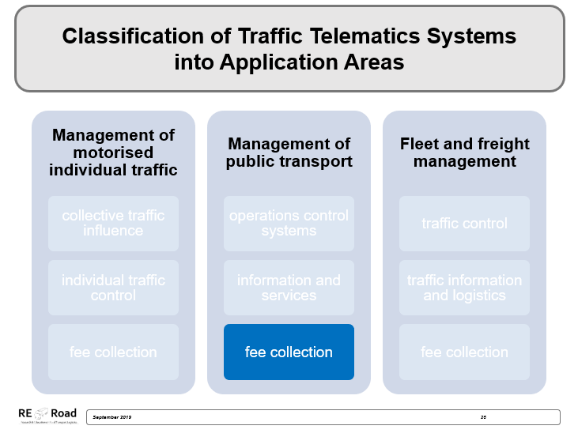
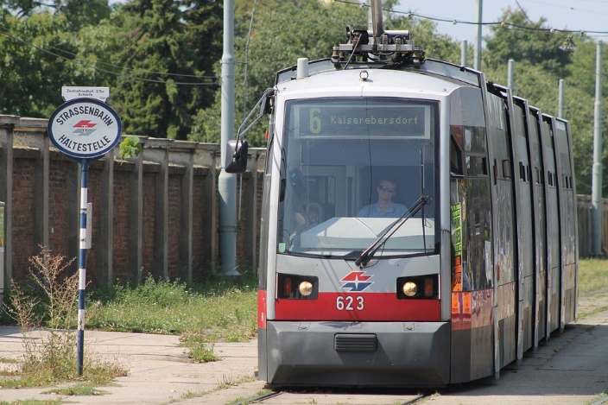

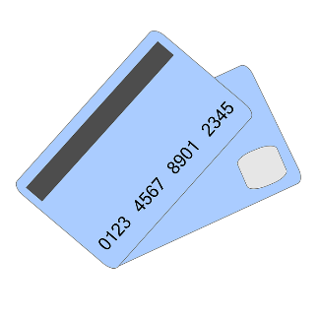
Online Tickets
Wiener Linien
Buy your ticket online
Notes:
Many tickets of the Wiener Linien can now also be purchased online. These can either be called up in the WienMobil App, printed out or delivered by post. In contrast to tickets purchased at vending machines, tobacconists or ticket offices, tickets purchased online or via the smartphone app are always personalized and therefore not transferable. However, they are always and everywhere easy to obtain and always with you on your mobile phone.
Source: See Wiener Linien (2019a), online; Wiener Linien (2019b), online
Image: pixabay (own composition)

Slide 19
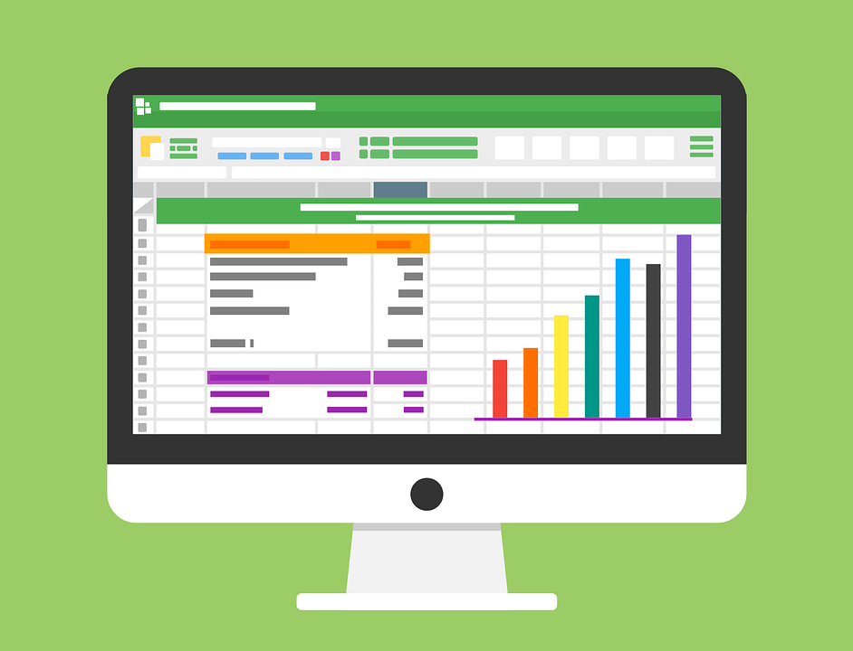
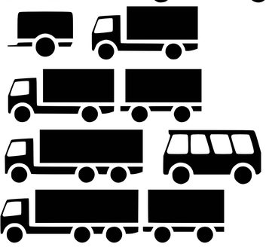
Fleet management
Large-scale fleet management encompasses all management tasks from acquisition, maintenance and replacement of vehicles to order process monitoring and planning.
Notes:
Fleet management is one application area of telematics. Large-scale fleet management encompasses all management tasks from acquisition, maintenance and replacement of vehicles to order process monitoring and planning. The focus is on improving communication between dispatcher and driver. Without telematics, information between the players is usually exchanged by mobile phone or radio. This results in numerous problems such as time delays, information loss due to media breaks, lack of accessibility or errors during manual transfer into a system.
The estimated time of arrival (ETA) can be stated in advance by determining the location and route of a truck. If there is an on-board computer on the truck, a tamper-proof driver's logbook can be created, facilitating compliance checks of the statutory rest periods. Telematics systems simplify administration thus economise personnel and material costs.
Source: Cf. Schrage (2010), online; vomFachmann(no year), online
Image: pixabay (own composition)

Slide 20
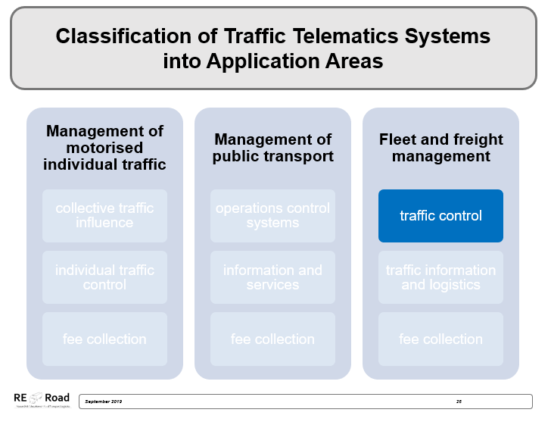


Convoy Control Kufstein
Without Convoy Control
With Convoy Control
Notes:
Convoy control in Kufstein (Tyrol) means the number of trucks is metered on certain days with forecast high traffic volumes. From 5 a.m. (the end of the night ban) in the south direction, the trucks are slowed down and, if necessary, brought to a standstill. Approximately 300 trucks per hour are then let through the checkpoint in order to avoid a traffic jam on the route. Convoy control usually takes place before or after public holidays or on days when a high volume of trucks is expected.
Source: Vgl. Weidner, M. et al (2018), online
Image: pixabay (own composition)

Slide 21
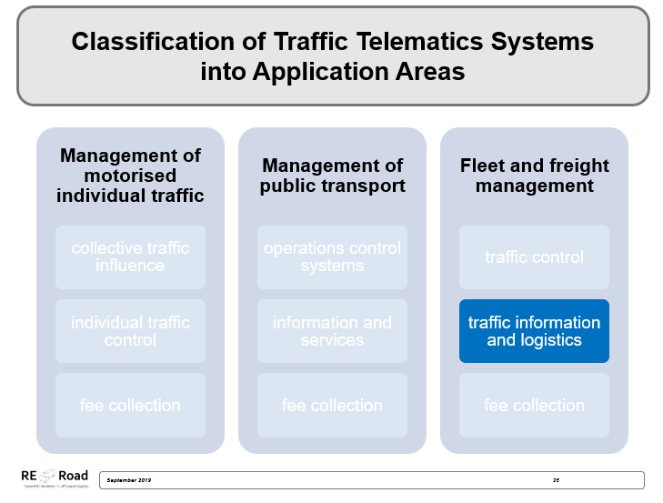
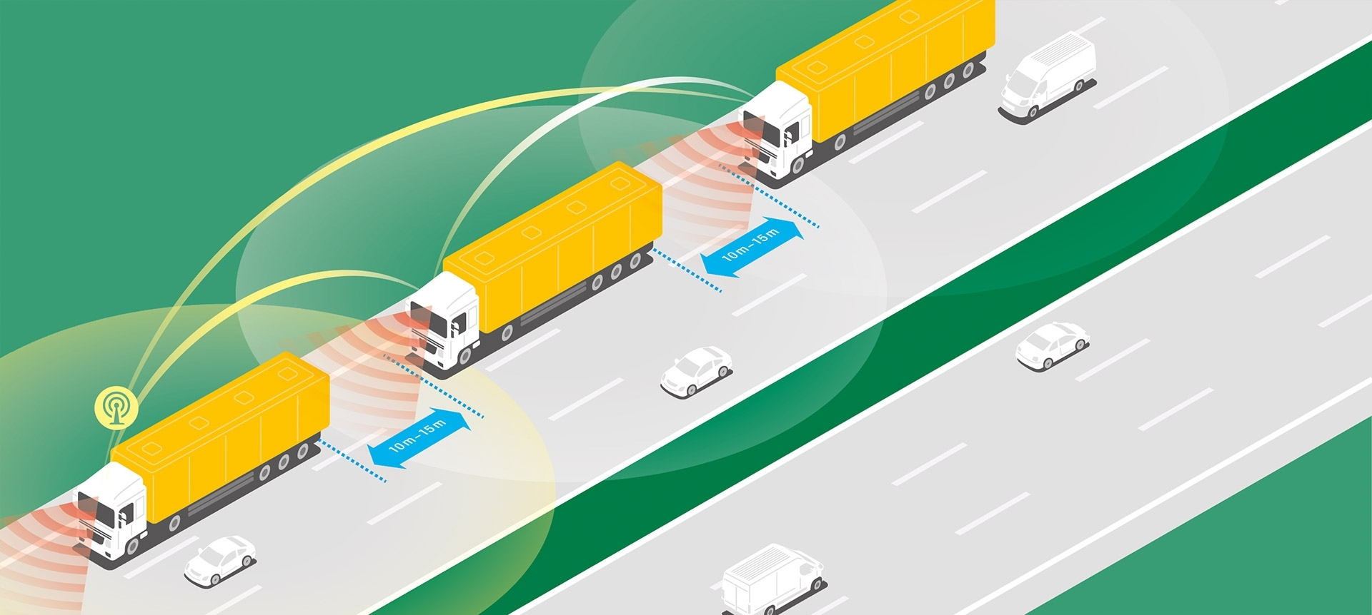
Platooning
Image: Verband der Automobilindustrie e.V
Notes:
The term "platooning" is a military term and can be described as a "truck convoy" or "networked columns". "Platooning" works like a classic freight train, with trucks instead of wagons attached to each other. Individual trucks are linked through innovative technologies (WLAN, GPS, Wi-Fi, etc.) and equipped with cutting edge systems (e.g. automatic braking systems or distance regulators). The driving behaviour of the group of trucks is controlled by the first truck. The vehicles travel at a speed of about 80 km/h at a constant distance of about 5 m. In the long run such a “train” could consist of up to 10 trucks and in addition to networked vehicles, a network with the infrastructure should be possible, too. Autonomous driving of trucks forms an important basis for this.
Strengths associated with this concept:
reduction of waiting times (better traffic flow)
increased efficiency (optimum capacity utilisation, reduced congestion, better coordination of loading and unloading)
reduced environmental impact
Resulting weaknesses from this concept:
increased road transport and stronger burden on infrastructure by more freight transport in the future
legal hurdles
different national regulations
Source: see Bay (2016) online; see European Truck Platooning Challenge (2016a) online; see Christof (2015) online; see Holzer (2016) online; see Scania Group (2013) 0:00-2:12.

Slide 22
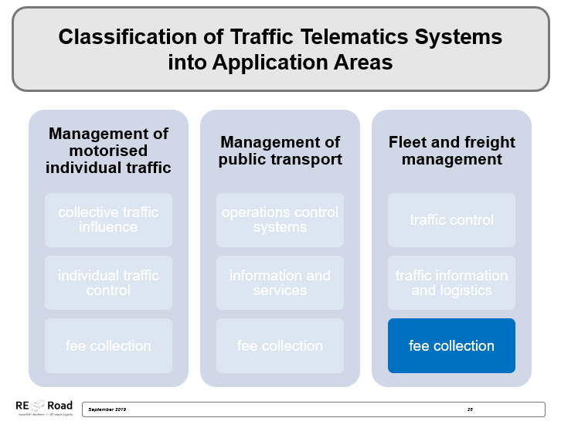
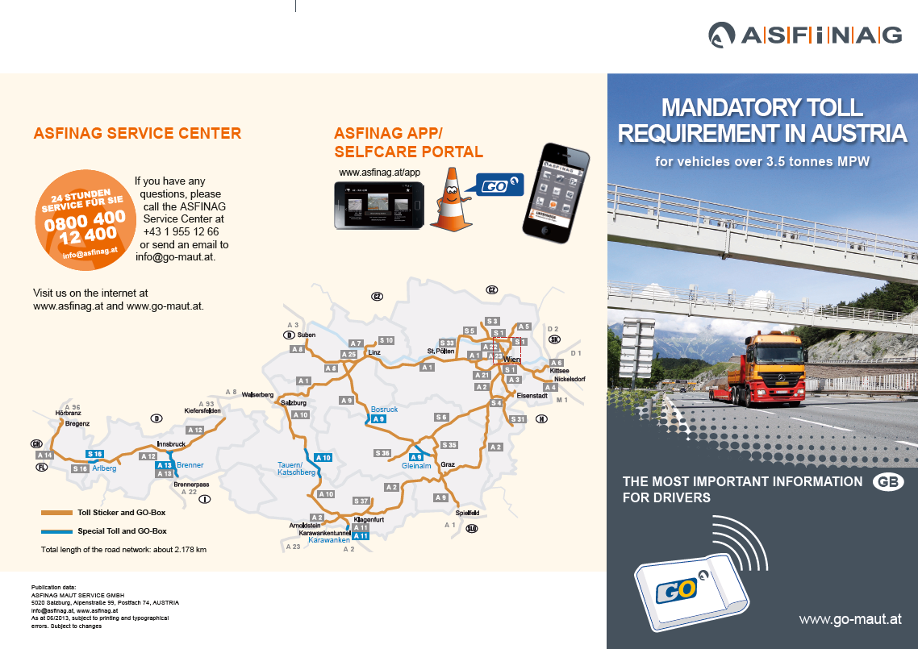
„Go-Toll“ - The Austrian Toll System
Image: ASFINAG
Notes:
Despite growing discussion about the introduction of a comprehensive toll system, only use of motorways and expressways is currently subject to the Austrian toll system. A general distinction is made between the "Vignette" system and the "GO Maut" system, the use of which is primarily dependent on the maximum permissible total weight of vehicles. Tolls and user charges are collected by ASFINAG (Autobahnen- und Schnellstraßen-Finanzierungs-Aktiengesellschaft). The "Vignette" system applies to cars and motor vehicles up to a maximum permissible total weight of 3.5 tonnes and to motorcycles. Owners of vehicles covered by this scheme must purchase a vignette for the use of Austrian motorways and expressways and affix it to the windscreen at the points provided for that purpose. Vignettes come as 10-day, 2-month or annual versions for which a one-off payment is made, allowing road network use without restriction during this period. In comparison, the "GO Box" system is characterised by the opposite principle. It applies to lorries, buses and heavy motor caravans which exceed the maximum permissible weight limit specified in the vignette system. In the "GO Maut" (Engl. toll) system, toll fees depend on the distance travelled. High-level road network use (= primary road network), incurs a corresponding fee. This means that each distance travelled is calculated separately or anew and no one-off amount is charged, as with the "Vignette" system. Individual tariffs depend on the number of axles and the respective emission class. The following applies: the better the emission class, the lower the applied tariff. The distance travelled by the vehicle is recorded by a mobile device, the "GO Box", which must be placed inside the vehicle on the windscreen. The "GO Box" employs microwave technology, a form of data transmission, to communicate with a toll portal (= a kind of thin steel bridge stretched across the road), which forms the basis for toll calculation. The advantage of the Austrian toll system is that the toll debit is not influenced by the lane used or the selected speed. This principle is also known in science as the "Multilane-Free-Flow" system.
It should be noted that special fares apply on certain routes in Austria (e.g. Pyhrn or Tauern motorways), added to the tolls already paid under the "Vignette" or "GO Maut" system.
Source: see Asfinag (2019a) online.
Image: Asfinag (2019): Madatory toll requirement in Austrian, in: https://www.go-maut.at/portal/portal, access on: 01.08.2019

Slide 23
Sources I
Andres, M. (2003): Telematiksysteme für die eLogistik. Anwendungsbereiche, Lösungen, Marktüberblick [Studie], available at: http://eurift.eu/file.php/telematik_broschuere.pdf-2005-10-27/telematik_broschuere.pdf, accessed 29.07.2016
Arena, F. / Pau G. (2019): An Overview of Vehicular Communications, in: Future Internet, 11/2, 27, available at: https://www.mdpi.com/1999-5903/11/2/27/pdaccessed am 06.04.2019
Asfinag (2016a): Die Vignette 2016, available at: http://www.asfinag.at/maut/vignette, accessed 13.10.2016
Asfinag (2016b): GO-Maut für Fahrzeuge über 3,5 Tonnen, available at: http://www.asfinag.at/maut/maut-fuer-lkw-und-bus, accessed 13.10.2016
Asfinag (2016c): GO Maut, available at: https://www.youtube.com/watch?v=IwXN96LdA2s, accessed 27.04.2019
Asfinag (o.J.): Verkehrsbeeinflussungsanlagen – Für mehr Sicherheit, available at: https://www.asfinag.at/verkehrssicherheit/verkehrsmanagement/verkehrssteuerung/, accessed 07.04.2019
Ausserer, K. / Risser, R. / Turetschek, C. / Reiss-Enz, V. (2006): Verkehrstelematik – der Mensch und die Maschine. Überblick über Verkehrstelematiksysteme und psychologische und sozialwissenschaftliche Überlegungen zum Thema Verkehr und Telematik, available at: https://www.bmvit.gv.at/verkehr/strasse/umwelt/downloads/studieTelematik2.pdf, accessed 07.04.2019
Bay, L. (2016): Lkw-Platooning. Schön der Reihe nach, in: Handelsblatt, Online-Ausgabe vom 04.04., available at: http://www.handelsblatt.com/unternehmen/industrie/lkw-platooning-schoen-der-reihe-nach/13399630.html, accessed 29.07.2016
Berg, C. C. / Rolf, J. (o.J.): Zum Einsatz der Telematik in der Supply Chain, available at: http://www.gvb-ev.de/fileadmin/pdfs/forschungsergebnisse_07.pdf, accessed 29.07.2016
Bosch (o.J.): V2X Vernetzungslösungen für Nutzfahrzeuge, available at: https://www.bosch-mobility-solutions.de/de/produkte-und-services/nutzfahrzeuge/vernetzungsl%C3%B6sungen/v2x-vernetzungsl%C3%B6sungen/, accessed 06.04.2019
Bundesministerium für Verkehr, Innovation und Technologie (o.J.): Telematik / intelligente Verkehrssysteme (IVS), available at: https://www.bmvit.gv.at/verkehr/gesamtverkehr/telematik_ivs/index.html, accessed 01.04.2019
Christof, F. (2015): V2V-Kommunikation. Platooning: Lkw im elektronisch gekoppelten Fahrzeugkonvoi, in: futurezone.at, Online-Ausgabe vom 12.03., available at: http://futurezone.at/science/
platooning-lkw-im-elektronisch-gekoppelten-fahrzeugkonvoi/116.088.643, accessed 29.07.2016
Dolak, G. (2018): Rechts stehen, links stauen, available at: https://www.bayernkurier.de/inland/31503-rechts-stehen-links-stauen/, accessed 23.04.2019
European Truck Platooning Challenge (2016a): What is Truck Platooning?, available at: https://www.eutruckplatooning.com/About/default.aspx, accessed 29.07.2016
Forschungsinformationssystem (2019): Dynamische Fahrgastinformation (DFI) mit RBL-Daten, available at: https://www.forschungsinformationssystem.de/servlet/is/191276/, accessed 23.04.2019
Gkogkidis, V. (2017): Gamification Tools: Kahoot, available at: https://gamificationplus.uk/gamification-tools-kahoot/, accessed 27.04.2019
Großmann, J. (2015): City-Maut: Wo die Durchfahrt kostet, available at: https://www.geo.de/reisen/reisewissen/926-rtkl-city-maut-wo-die-durchfahrt-kostet, accessed 27.04.2019

Slide 24
Sources II
Holzer, H. (2016): Vernetzte Lkw: Rollende Datencenter, in: Zeit Online, Online-Ausgabe vom 08.05., available at: http://www.zeit.de/mobilitaet/2016-04/logistik-lkw-vernetzung-digitalisierung, accessed 29.07.2016
next:urban technologies GmbH (o.J.): urban station, available at: https://www.nexturban.at/urban-station/, accessed 23.04.2019
ÖBB (o.J.): SCOTTY mobil, available at: https://www.oebb.at/de/fahrplan/fahrplanauskunft/scottymobil.html, accessed 23.04.2019
ÖBB Personenverkehr AG (o.J.): Google Play: ÖBB Scotty, available at: https://play.google.com/store/apps/details?id=de.hafas.android.oebb&hl=de_AT, accessed 23.04.2019
Randelhoff, M. (2017): Automatisierung des Straßengüterverkehrs, available at: https://www.zukunft-mobilitaet.net/113531/analyse/automatisierung-strassengueterverkehr-selbstfahrende-LKW-autonom-automatisierte-nfz-nutzfahrzeuge/, accessed 06.04.2019
Rauch, M. (2013): Autobahn- und City-Maut für Ausländer: Skepsis bei Asfinag und Stadt Bregenz, available at: https://www.vol.at/autobahn-und-city-maut-fuer-auslaender-skepsis-bei-asfinag-und-stadt-bregenz/3755358, accessed 27.04.2019
Sammer, G. (2012): Wirkungen und Risiken einer City-Maut als zentrale Säule eines städtischen Mobilitätskonzepts. In: Proff H., Schönharting J., Schramm D., Ziegler J. (eds) Zukünftige Entwicklungen in der Mobilität. Gabler Verlag
Scania Group (2013): Platooning [Video], YouTube, 03.10., available at: https://www.youtube.com/watch?v=X3fF6m4ks1g, accessed 26.07.2016
Schrage, R. (2010): Flottenmanagement und Telematik, available at: https://www.uni-koblenz-landau.de/de/koblenz/fb4/ist/AGZoebel/Lehre/ss2011-ordner/sem_asida/Seminar10Ausarbeitungen/schrage, accessed 19.07.2019
Steirische Tourismus GmbH (o.J.): Die Apps der ÖBB für Öffis, available at: https://www.steiermark.com/de/service/apps/oebb-app, accessed 23.04.2019
Synoposis.com (2019): Dude, Where’s My Autonomous Car? The 6 Levels of Vehicle Autonomy, available at: https://www.synopsys.com/automotive/autonomous-driving-levels.html, Zugriff am: 30.7.2019
TomTom (o.J.): Die Geschichte der Telematik. Ein kurzer Überblick, available at: https://static.telematics.tomtom.com/_ttt/lib/assets/ttt/doc/whitepapers/de_at/ttt-history-of-telematics.pdf, accessed 06.04.2019
Verband der Automobilindustrie (o.J.): Automatisiertes Fahren. Platooning – Innovation im Güterverkehr, available at: https://www.vda.de/de/themen/innovation-und-technik/automatisiertes-fahren/platooning.html, accessed 06.04.2019
vomFachmann (o.J.): LKW Telematik – Preise und Anbieter, available at: http://www.vomfachmann.de/LKW-telematik-preise-und-anbieter, accessed 06.04.2019
Weidner, M. / Hunger, M. / Zwigl, M. / Schlenker, K. (2018): Blockabfertigung: Verkehr auf A8 und A93 hat sich normalisiert, available at: https://www.rosenheim24.de/rosenheim/inntal/kufstein-ort44506/kufstein-landkreis-transitverbot-blockabfertigung-naechste-staus-erwartet-neu-9813519.html, accessed 23.04.2019
Wiener Linien (2019a): Mobile Tickets, available at: https://www.wienerlinien.at/eportal3/ep/channelView.do/pageTypeId/66526/channelId/-4400535, accessed 23.04.2019
Wiener Linien (2019b): Der richtige Fahrschien, der passende Tarif, available at: https://www.wienerlinien.at/eportal3/ep/channelView.do/pageTypeId/66526/channelId/-46648, accessed 23.04.2019
Wiener Linien (2019c): How-To: Jahreskarte in der WienMobil-App anzeigen, available at: https://blog.wienerlinien.at/how-to-jahreskarte-in-der-ticket-app-anzeigen/, accessed 23.04.2019
Wiener Städtische (2017): Neue Risiken durch autonomes Fahren, available at: https://www.wienerstaedtische.at/unternehmen/presse/pressemeldungen/detail/neue-risiken-durch-autonomes-fahren.html, accessed 06.04.2019

Slide 25

Additional information
We hope our PowerPoint presentation meets your requirements!
You are welcome to adapt this presentation according to your wishes and requirements and to use it for your lessons/lectures.
We are happy to receive your questions or feedback at reroad@fh-vie.ac.at .
Further PowerPoint slides and teaching materials at http://www.retrans.at/de/

