Slide 1
Road Transport
Current Trends

Slide 2
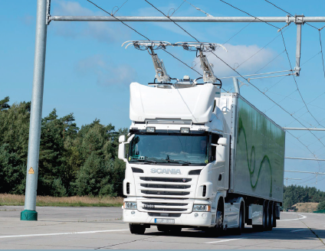
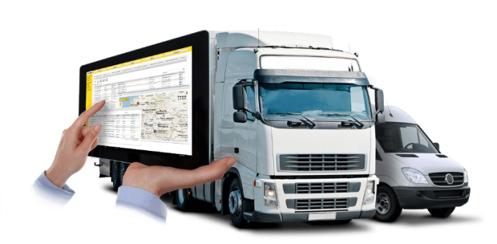
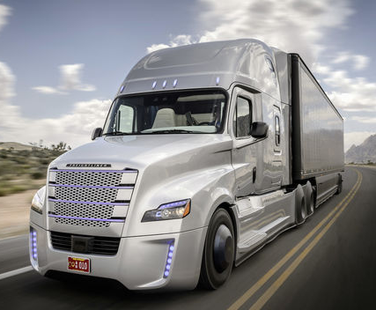
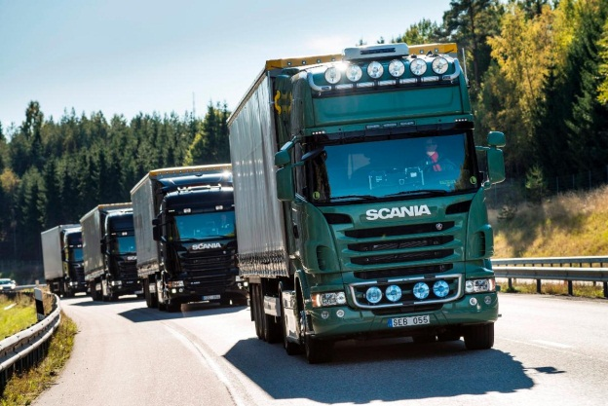

Some Recent Trends in Road Transport
Siemens (2015) p. 4.
YellowFox (2013) online.
telematics
electric drive
Daimler Trucks (2015) online.
Scania (2016) online.
Tecosol (2012) online.
platooning
self-driving truck
biofuels
Notes:
Images: YellowFox (2013) online; Siemens (2015) online; Daimler Trucks (2015) online; Scania (2016) online; Tecosol (2012) online.

Slide 3
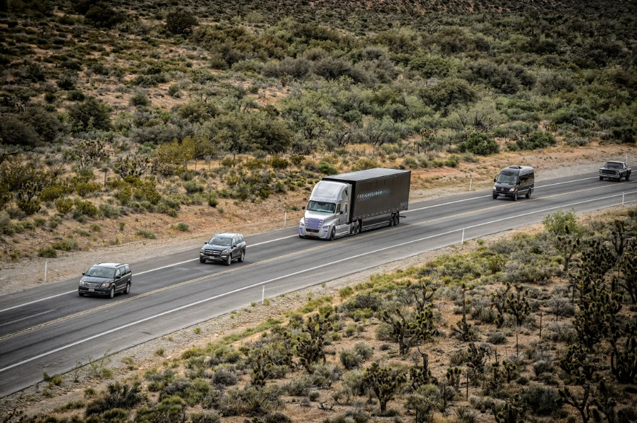
Short Overview Self-driving Truck
strengths
increased efficiency
increased safety
job profile upgrade
Characteristics:
autopilot
different systems
intervention possibilities
weaknesses
legal hurdles
different national legal situations
Notes:
The concept of the self-driving truck is based on the autopilot in the aircraft. When the function is activated the lane, vehicle distance and speed are automatically determined and maintained using various systems (radar sensors, stereo cameras, assistance systems or distance controllers). However, the new concept does not replace drivers in road freight transport. Rather, they still have control over the vehicle and can decide individually when the self-driving system is to be switched on or off. Especially in situations that are no longer controllable by the autopilot (e.g. thunderstorms or narrow loading and unloading areas), the responsibility is again transferred to the driver. If the driver does not react (even after repeated signalling) for whatever reason, braking is automatically initiated for safety reasons.
Content: Cf. APA (2015) online; Cf. Postinett (2015) online; Cf. AFP (2015) online; Cf. APA/DPA (2015) online; Cf. Verkehrsrundschau (2015) 2:16-10:04 min.; Cf. DPA (2015) online.
Image: Daimler Trucks (2015) online.

Slide 4
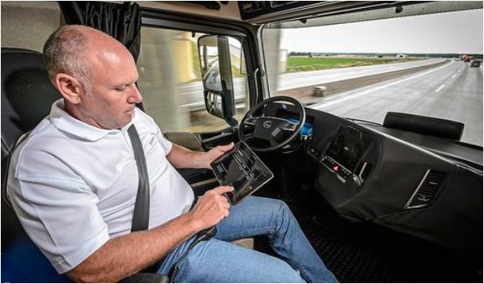
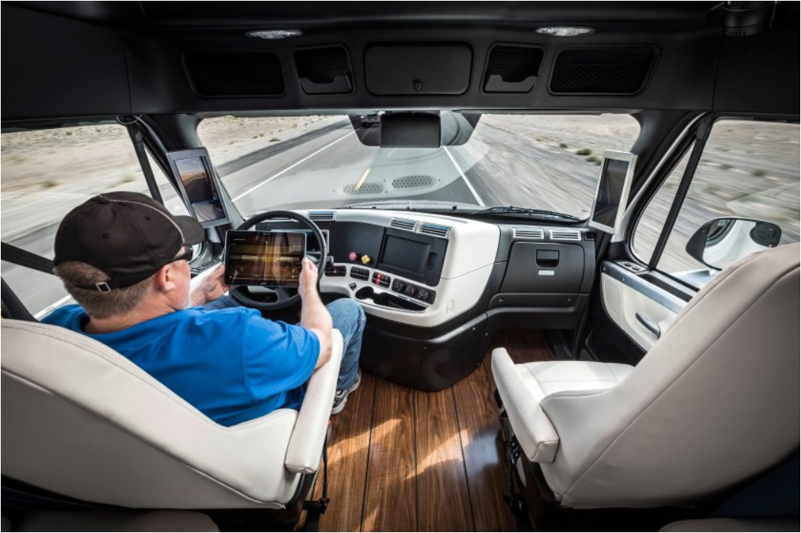
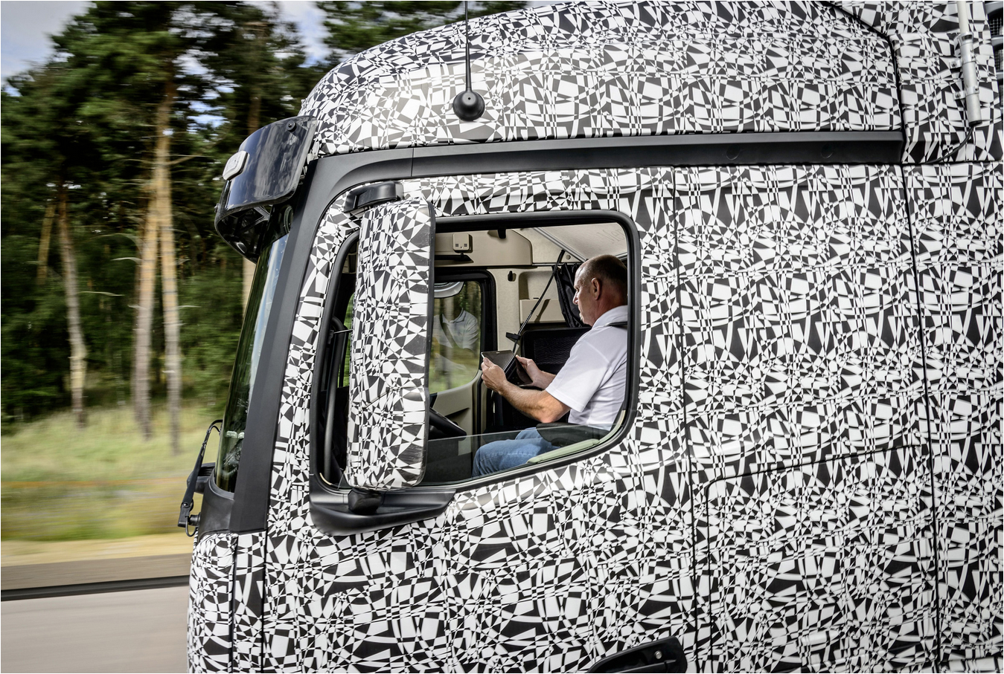
New Job Profile for Truck Drivers?
Daimler Trucks (2015) online.
self-driving truck
Notes:
Which tasks will truck drivers take on in the future?
The driver rests in the driver's seat or does other work: He/she makes telephone calls to customers, revises the route plan on the tablet, books a parking space or takes care of correspondence. The boundaries between driving and dispatching may blur. This could stand for an upgraded job profile, further training and additional qualifications.
In principle, the focus is on relieving the burden on drivers and on accident safety. Saving jobs is not primarily intended. Nevertheless, this could lead to different driving and resting time models if necessary.
Sources: Kleine Zeitung (2015), online; Daimler Trucks (2015), online; Spiegel.de (2016), online; ZF Zukunftsstudie (2014), online

Slide 5
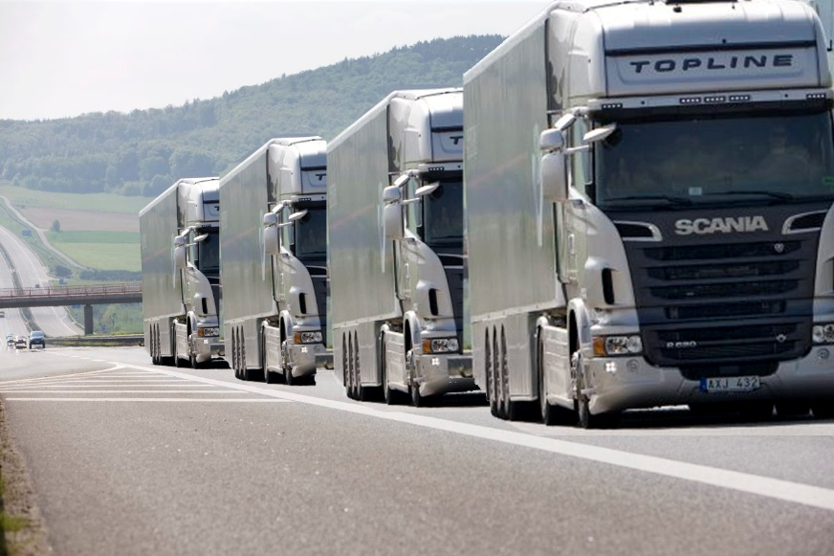
Short Overview Platooning
strengths
better traffic flow
Increased efficiency
environmental relief
Characteristics:
networked columns
innovative techniques
about 10 trucks per convoy
weaknesses
focus on the road
legal hurdles
different national legal situations
Notes:
The term "platooning" derives from the military sector and can also be described as a "truck convoy" or "networked columns". Platooning works like a classic freight train, only that no wagons but trucks are attached to each other. The individual trucks are networked using innovative technologies (WLAN, GPS, Wi-Fi, etc.) and equipped with the latest systems (e.g. automatic braking systems or distance regulators). The driving behavior of the truck train is controlled by the first truck. The vehicles travel at a speed of about 80 km/h at a constant distance of about 5 m. The concept aims at the fact that 10 trucks can be part of such a train and in the long run not only a network between the vehicles, but also with the infrastructure is to be made possible. Autonomous truck driving forms an important basis for this.
Quelle-Inhalt: Vgl. Bay (2016) online; Vgl. European Truck Platooning Challenge (2016a) online; Vgl. Christof (2015) online; Vgl. Holzer (2016) online; Vgl. Scania Group (2013) 0:00-2:12.
Source image: RSGB Limited (2014) online.

Slide 6
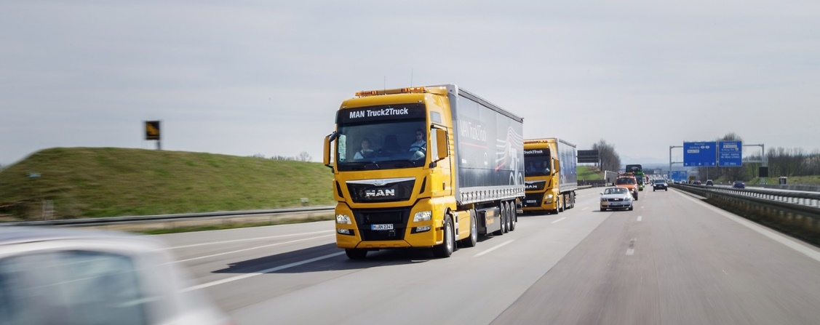
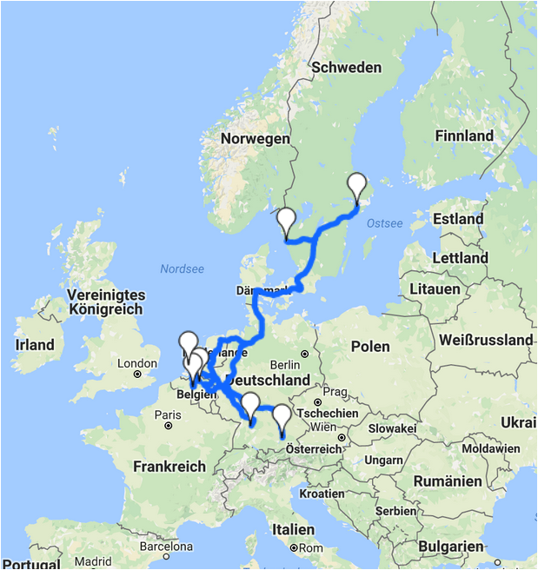
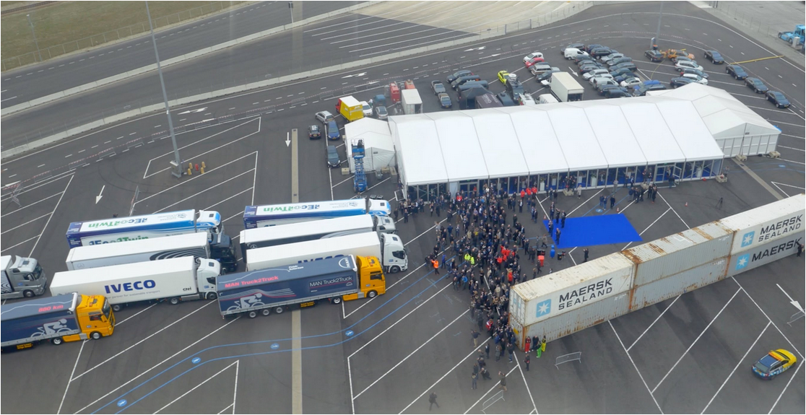
"European Truck Platooning Challenge"
Notes:
In April the "European Truck Platooning Challenge“, initiated by the Dutch government during its EU Council Presidencywas, launched. A total of six manufacturers, Daimler, MAN, Scania, Volvo, DAF and Iveco, are taking part in the experiment. They let their trucks roll in networked columns to the port of Rotterdam. MAN trucks started in Munich, Daimler trucks in Stuttgart, driving via Frankfurt to Rotterdam. But the columns also rolled over Germany from Scandinavia. Scania started its networked trucks in Södertälje, Sweden, Volvo in Gothenburg. Their way led via Bremen to the Netherlands. The trucks are connected to platoons by means of digital data transmission and can automatically drive one behind the other at short intervals. On the one hand, this is intended to make better use of the road space. On the other hand, the trucks drive in the slipstream, which means they consume less fuel and thus emit fewer pollutants.
Further information: https://www.eutruckplatooning.com/default.aspx
Further sources:
http://www.truck.man.eu/de/de/man-welt/man-stories/Challenge-gemeistert-257154.html
https://www.eutruckplatooning.com/About/Corridors+to+drive+MAP/default.aspx

Slide 7
Short Overview Electric drive exemplified by "eHighway"
strengths
protection of the environment
economical goods transport
quick feasibility
Combination of hybrid drive and supply with electrical energy
weaknesses
investment and implementation costs
grounding of overhead lines
Notes:
The "eHighway" concept is based on a combination of hybrid drive and electrical power supply. The electrical energy is drawn from an overhead line, as in rail transport, or supplemented by a classic combustion engine, fuel cells or biofuels in the absence of an overhead line. A scanner in the truck checks availability of an overhead line and can be coupled to it automatically or manually.
Content: Siemens AG (2012) p. 4 ff; Randelhoff (2012) online; Siemens AG (2014) 0:00-2:01.
Image: Siemens (2015) p. 4.

Slide 8
Short Overview Biofuels
strengths
occasionally immediately usable or smaller conversions
lower emissions
3 generations:
bioethanol, biodiesel
biomethane, cellulose-ethanol
algae, cultivated plants
weaknesses
use of food
heavy land use for production
Notes:
Biofuels can be described by their generations. The first generation comprises bioethanol (mainly from cereals, such as wheat and corn, or sugar beet) and biodiesel (from rapeseed, vegetable oils or waste materials such as animal fats). The second generation includes biomethane (bio natural gas) - produced from the primary product "biogas" -, cellulose-ethanol (raw material: cellulose from straw or wood waste) or BtL fuels (biomass-to-liquid). The third and last generation includes above all the extraction of biofuel from algae or special cultivated plants.
Content: Cf. WKO (2016) p. 36; cf. Unabhängiges Institut für Umweltfragen (no year) slide 22; cf. Shell Deutschland Oil Gmbh (2010) p. 38 ff; cf. ARD Mittagsmagazin (2012) 0:00-2:47.
Image: Tecosol (2012) online.

Slide 9
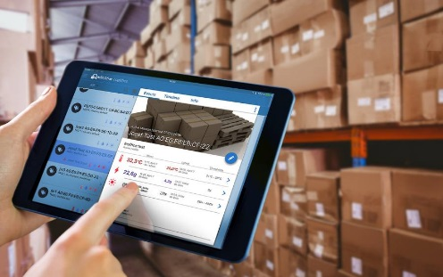
Short Overview Telematics
Fields of application
fleet management
assistance system
toll accounting
Definition of terms:
telecommunications and informatics
communication / exchange of information
Example
Notes:
The term "telematics" links telecommunications and information technology, forming an important basis for our daily activities (e.g. traffic control systems or automatic parking guidance systems). Among other things, telematics is intended to facilitate communication between operators. In the transport sector, the vehicle requires, for example, a peripheral device for the recording and transmission of information or data (e.g. an on-board computer).
Content: Cf. Berg/Rolf (n/a) p. 2 ff; cf. Andres (2003) p. 3 ff; cf. Bäumler (2015) p. 22 ff.
Image: YellowFox (2013) online; IT Zoom (2016) online.

Slide 10
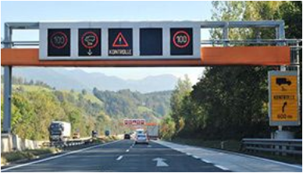
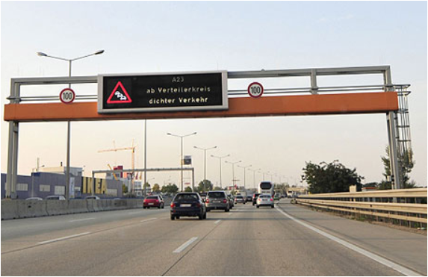
Traffic Control System (German: Verkehrsbeeinflussungsanlage VBA)
Aims
better traffic flow
less congestion
more road safety
less environmental impact
Notes:
Better traffic flow, more traffic safety, less congestion and environmental pollution are the objectives when using traffic control systems (VBA) in the ASFINAG route network of which 17 are currently in operation throughout Austria. Traffic control systems can be used to react promptly to sudden, unforeseeable events - such as an accident with recommendations for alternative routes.
Sources: Asfinag (2017), online; Wien.orf.at (2012), online

Slide 11
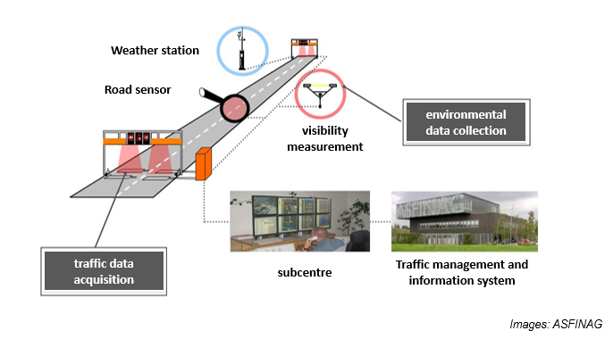
Functional Diagram of a Traffic Control System
Notes:
A large number of sensors record traffic and environment data along motorways and expressways. On the one hand, they detect traffic volume and speeds, and on the other hand weather-related hazards such as wet road conditions or visual impairments. Depending on the measured data, different speed restrictions or warnings are automatically switched to the traffic control system.
Much, however, is taken over by the operators. They work around the clock in the nine regional traffic management centres throughout Austria and have an overview of the ASFINAG network. In the event of events such as accidents or breakdowns, they can manually switch speed limits and warnings.
There are two types of VBA:
Route control systems inform the road network about sudden events (e.g. accidents or snow) and harmonise speeds on the basis of the prevailing conditions (traffic volume, congestion and much more).
In the event of an incident, network control systems can propose an alternative route directly along the motorway to the overhead signposts or divert traffic to them.
Sources: Asfinag (2017a), online

Slide 12
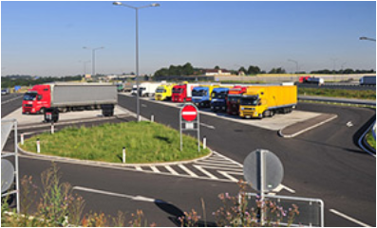
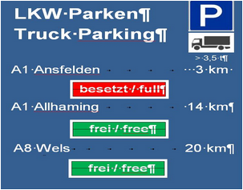
Parking Space Information System for Trucks
truck parking spaces
information signs with status displays
Notes:
Truck Parking Information supports professional drivers when looking for free parking spaces. With the ASFINAG App "Unterwegs" (Engl. "on the road“) these parking spaces can also be viewed on mobile phones.
Occupancy of truck parking spaces is constantly monitored and kept up to date by employees of regional traffic management centres. The display on the route is on overhead signposts or alternate text displays. If such signs are not available on a motorway section, put up signs pass on status indications to truck drivers. In addition, ASFINAG's online webcams support parking space search. These webcams can be viewed via the ASFINAG homepage, the traffic information service and the ASFINAG "Unterwegs" app, for example, so that the available truck parking spaces can be found easily.
Source: Asfinag (2017b):

Slide 13
References I
Agence France-Presse (AFP) (2015): Gesteuert per Autopilot. Der erste selbstfahrende Lkw ist unterwegs, in: Der Tagesspiegel, Online-Ausgabe vom 02.10., bezogen unter: http://www.tagesspiegel.de/wirtschaft/gesteuert-per-autopilot-der-erste-selbstfahrende-lkw-ist-unterwegs/12402014.html accessed 27July 2016
Andres, M. (2003): Telematiksysteme für die eLogistik. Anwendungsbereiche, Lösungen, Marktüberblick [Studie], accessed at http://eurift.eu/file.php/telematik_broschuere.pdf-2005-10-27/telematik_broschuere.pdf, accessed 29 July 2016
ARD Mittagsmagazin (2012): Biokraftstoffe: Pro und Contra [Video], YouTube, 25 September., accessed at https://www.youtube.com/watch?v=rzVIssYb06Y
Asfinag (2017a): Für mehr Verkehrssicherheit: Verkehrsbeeinflussungsanlagen, in: https://www.asfinag.at/unterwegs/verkehrssicherheit/verkehrssteuerung, accessed 31 January 2017
Asfinag (2017b): Stellplatz-Infosystem für Lkw, in: https://www.asfinag.at/unterwegs/lkw-bus/lkw-stellplaetze, accessed 31 January 2017
Austria Presse Agentur (APA) (2013): Selbstfahrende Lkw: Daimler ortet Probleme, bezogen unter: http://www.spediteure-logistik.at/news/aktuelle-meldungen/aktuelle-meldungen/selbstfahrende-lkw-daimler-ortet-probleme.html, accessed 26 July 2016
Austria Presse Agentur (APA) / Deutsche Presse Agentur (DPA) (2015): Daimler schickt selbstfahrenden Lkw auf US-Highway, in: DiePresse.com, Online-Ausgabe vom 06.05., accessed at: http://diepresse.com/home/motor/4724915/Daimler-schickt-selbstfahrenden-Lkw-auf-USHighway, accessed 27July 2016
Bay, L. (2016): Lkw-Platooning. Schön der Reihe nach, in: Handelsblatt, Online-Ausgabe vom 04.04., accessed a: http://www.handelsblatt.com/unternehmen/industrie/lkw-platooning-schoen-der-reihe-nach/13399630.html, accessed 29 July 2016
Bäumler, I. (2015): Überblick über die Telematiksysteme für den Straßengüterverkehr, Schriftenreihe des Lehrstuhls für Logistikmanagement, accessed at: http://www.lm.uni-bremen.de/files/
kotzab/Schriftenreihe/SR_2015_2_final_mit%20ISSN.pdf, accessed 29 July 2016
Berg, C. C. / Rolf, J. (o.J.): Zum Einsatz der Telematik in der Supply Chain, accessed at: http://www.gvb-ev.de/fileadmin/pdfs/forschungsergebnisse_07.pdf, accessed 29 July 2016
Christof, F. (2015): V2V-Kommunikation. Platooning: Lkw im elektronisch gekoppelten Fahrzeugkonvoi, in: futurezone.at, Online-Ausgabe vom 12.03., accessed at http://futurezone.at/science/
platooning-lkw-im-elektronisch-gekoppelten-fahrzeugkonvoi/116.088.643, accessed 29 July 2016
Deutsche Presse Agentur (DPA) (2015): In Amerika. Daimlers Premiere mit selbstfahrenden LKW, in: Frankfurter Allgemeine, Online-Ausgabe vom 06.05., accessed at http://www.faz.net/aktuell/
wirtschaft/unternehmen/daimler-darf-selbstfahrende-lastwagen-testen-13577148.html, accessed 27July 2016
European Truck Platooning Challenge (2016a): What is Truck Platooning?, accessed at: https://www.eutruckplatooning.com/About/default.aspx, accessed 29 July 2016
Holzer, H. (2016): Vernetzte Lkw: Rollende Datencenter, in: Zeit Online, online edition 08 May, accessed at http://www.zeit.de/mobilitaet/2016-04/logistik-lkw-vernetzung-digitalisierung, accessed 29 July 2016
Kleine Zeitung (2015): Erster selbstfahrender Lkw auf der Autobahn, in: http://www.kleinezeitung.at/wirtschaft/4835495/DaimlerTest_Erster-selbstfahrender-Lkw-auf-der-Autobahn, accessed 29 July 2016

Slide 14
References II
Postinett, A. (2015): Selbstfahrender LKW auf US-Straßen. Wenn der Trucker freihändig fährt, in: Handelsblatt, online edition 6 May, accessed at http://www.handelsblatt.com/unternehmen/industrie/selbstfahrender-lkw-auf-us-strassen-wenn-der-trucker-freihaendig-faehrt/11733230.html, accessed 26 July 2016
Randelhoff, M. (2012): Siemens eHighway, Hybrid-NFZ, LNG: Fährt der Straßengüterverkehr der Zukunft elektrisch?, blog entry 21 May, Zukunft Mobilität, accessed at http://www.zukunft-mobilitaet.net/9593/zukunft-des-automobils/elektromobilitaet/ehighway-siemens-hybrid-lkw-elektroantrieb/, accessed 29 July 2016
RSGB Limited (2014): DfT commissions ‘platooning’ study, accessed at http://www.roadsafetygb.org.uk/news/3301.html, accessed 12 October 2016
Scania Group (2013): Platooning [Video], YouTube, 3 October, accessed at https://www.youtube.com/watch?v=X3fF6m4ks1g, accessed 26 July 2016
Shell Deutschland Oil Gmbh (2010): Shell LKW Studie. Fakten, Trends und Perspektiven im Straßengüterverkehr bis 2030, accessed at http://www.dlr.de/Portaldata/1/
Resources/portal_news/newsarchiv2010_3/Shell_Lkw_Studie_FIN_17042010.pdf, accessed 29 July 2016
Siemens AG (2012): Mit eHighway in die Zukunft. Innovative Lösungen für den Straßengüterverkehr, Bericht, accessed at http://www.siemens.com/press/pool/de/feature/2012/infrastructure-cities/mobility-logistics/2012-05-lkw/brochure-ehighway-d.pdf, accessed 29 July 2016
Spiegel.de (2016): "In zehn Jahren werden keine Lkw-Fahrer mehr benötigt„, in: http://www.spiegel.de/wirtschaft/unternehmen/autonome-lkw-in-zehn-jahren-werden-keine-fahrer-mehr-benoetigt-a-1112566.html, accessed 30 January 2017
Unabhängiges Institut für Umweltfragen (o.J.): Alternative Mobilität [Präsentation], accessed at https://www.google.at/#q=bio+kraftstoffe+pr%C3%A4sentation+ufu, accessed 29 July 2016
Verkehrsrundschau (2014): Future Truck 2025 - der selbstfahrende LKW [Video], YouTube, 14 July, accessed at https://www.youtube.com/watch?v=iR5MAlpIbxY, accessed 26July 2016
Wien.orf.at (2012): Neues Leitsystem gegen Staus auf A23, at http://wien.orf.at/news/stories/2522882/, accessed 31 January 2017
Wirtschaftskammer Österreich (WKO) (2016): Ökologisierung des Verkehrs, accessed at https://www.wko.at/Content.Node/branchen/oe/TransportVerkehr/Oekologisierung-des-Verkehrs-2016.pdf, accessed 29 July 2016
ZF-Zukunftsstudie (2014): Der LKW der Zukunft kann autonom fahren, at https://www.zf-zukunftsstudie.de/der-lkw-der-zukunft-kann-autonom-fahren/, accessed 30 January 2017

Slide 15

Additional Information
We hope our PowerPoint presentation meets your requirements!
You are welcome to adapt this presentation according to your wishes and requirements and to use it for your lessons/lectures.
We are happy to receive your questions or feedback at reroad@fh-vie.ac.at .
Further PowerPoint slides and teaching resources at
http://www.retrans.at/de/

