Slide 1
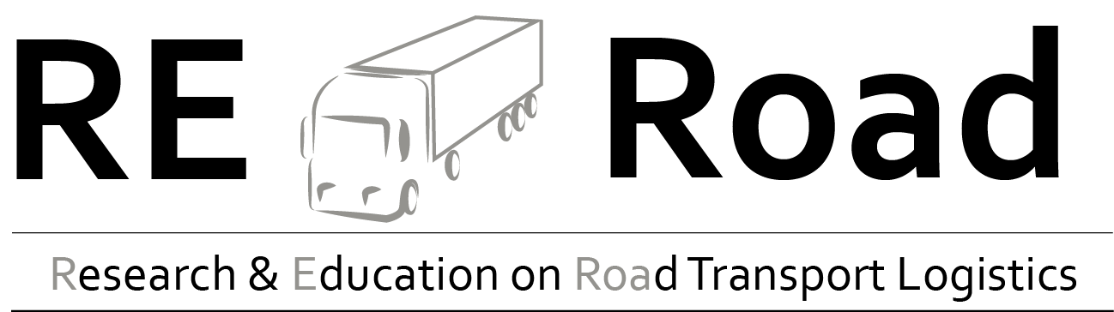
Sustainability in
Freight Transport

Slide 2
Agenda
Case Study
Sustainability in transport and SCM
Modal Split and Modal Shift
Transport modes
Freight transport in general

Slide 3

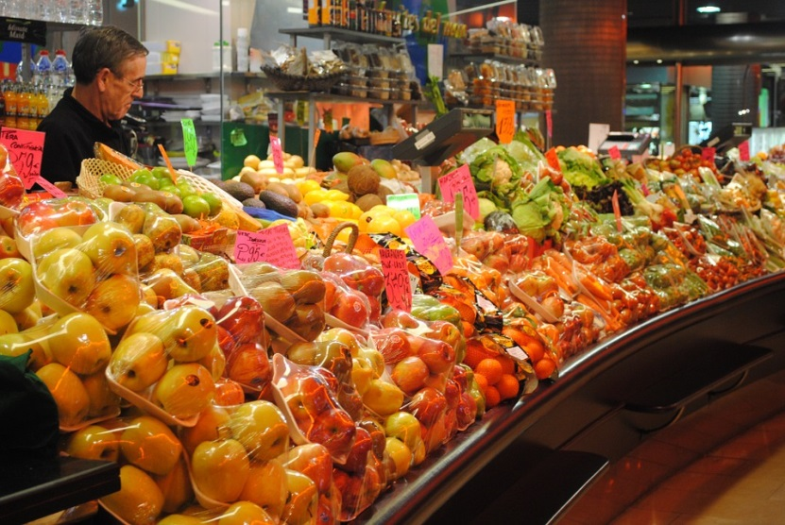
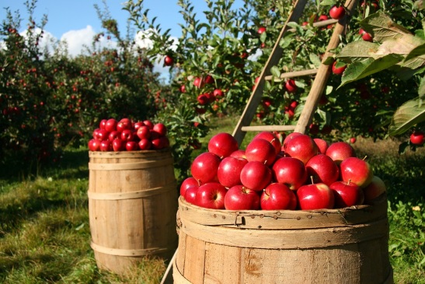
Warm up: Transport modes
This is Peter. He’d like to sell his apples but doesn’t know how to get them to his customer - a food retailer in Austria.
How can Peter transport his products to his customer?
Notes:
A discussion may be helpful for introducing the topic of “transport modes”.
The transport modes and means of transport are responsible for bringing products and goods from production facilities to recipients. The choice of means of transport determines the price of the end product and also influences the duration of transport. However, these are just two of the criteria that are used for choosing a means of transport. There are also other criteria which influence the selection of the means of transport.
Possible discussion questions (5-10 minute discussions):
What means of transport are there?
What criteria can be applied for choosing a means of transport?
What impact do the product properties have on the choice of means of transport?
Input - possible points for discussion:
Speed and costs
Apples need to be refrigerated and transported to the supermarket as quickly as possible
Packaging is also important when transporting foodstuffs like apples
Seasonality of apples

Slide 4
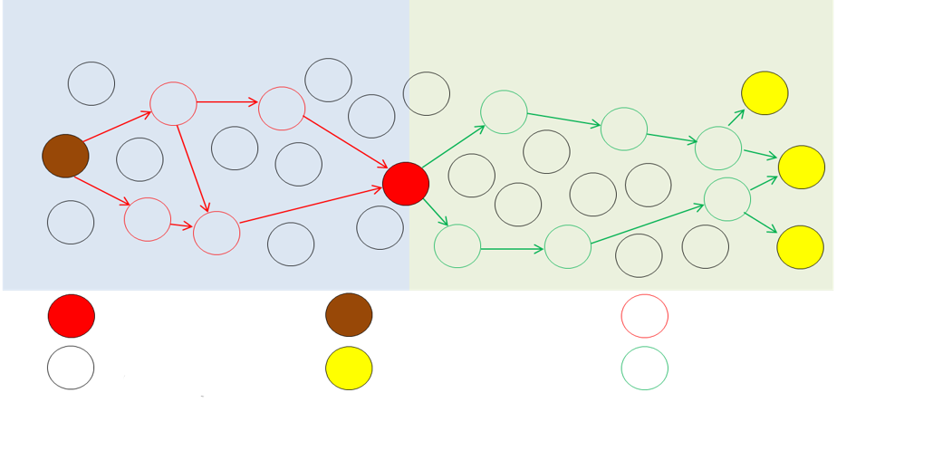
Freight transport in general
The transport of goods and products is an important part of logistics
All actors, from raw material suppliers to end customers, are connected through transport
There are various means of transport used for this
_{Procurement side}
_{Distribution side}
_{...Own company}
_{...Raw material supplier}
_{...Suppliers}
...Other companies (outside the network, e.g. competitors, other suppliers)
_{...End customer (B2B) or}
_{Consumer (B2C)}
_{...Wholesaler or retailer}
Image: author’s presentation, following Handorsson et al.
Notes:
An important part of logistics is the transport of goods. Transport combines all actors on the value creation chain - from raw material suppliers to end customers. There are lots of different transport modes (road, railway, waterway), and means of transport (trucks, small transporters etc.) that can be used for this transport.
Source:
Cf. Kummer et al., 2009, pp. 259 – 261

Slide 5
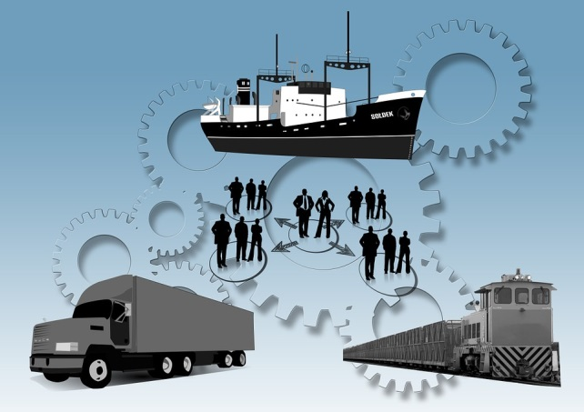
Freight transport in general
Selecting the mode of transport
Properties of the
product being transported have to be
co-ordinated with the modes of transport
→ Situation-dependent decision
important indicators:
  Duration of transport
  Capacity
  Punctuality
  Security
  Coverage
  Costs
  Eco-friendliness (e.g. CO2 emissions and energy consumption)
Notes:
The sender’s decision of which mdoes of transport he can use to transport his goods from A to B is an important factor in the financial success (or failure) of a company. It is important in this respect to compare the properties of the product being transported with the specific characteristics of each mode of transport in order to find the most suitable modes of transport for the job.
Important factors here are:
Duration of transport;
Capacities of the means of transport;
Its punctuality and reliability;
Security aspects;
Its coverage, i.e. the available infrastructure (keyword: available ports/waterways, rail network)
The costs and
Eco-friendliness aspects (e.g. CO2 emissions and energy consumption)
Of course, each decision should be made on a case-by-case basis since often different means of transport are required for the same type of goods. This is the case, for example, when a customer needs his goods earlier on one occasion, but specifies a longer delivery time on another occasion. On the next slide, we present the various different transport modes and means of transport.
Source:
Cf. Kille & Schmidt, 2008, pp. 13-14
Image source:
https://pixabay.com/en/logistics-truck-freight-train-877566/

Slide 6
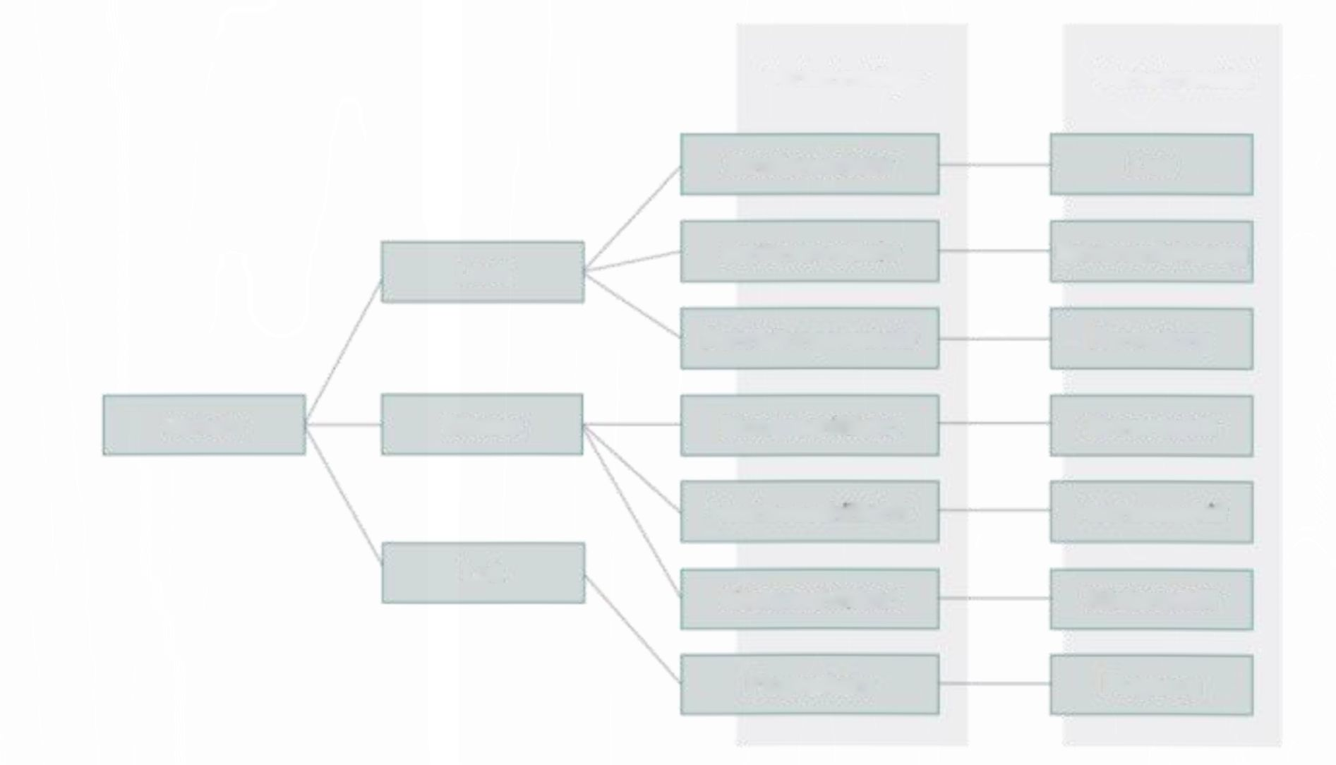
Freight transport in general
Transport modes and means of transport
Means of transport: Vehicle for transporting people and goods
(train, inland vessel, truck, etc.)
Transport modes: Infrastructure for using the means of transport
(e.g. roads, railways, waterways, etc.)
Transport modes
Means of transport
Road transport
Truck
Land
Rail transport
Rail vehicle
Pipeline transport
Pipeline
Transport
Water
Inland waterway transport, inland navigation
Inland vessel
Seagoing vessel, maritime vessel
Seagoing vessel, maritime vessel
Air
Coastal vessel transport
Coastal vessel
Air transport
Aeroplane
Overview of transport modes and means of transport (Source: viadonau based on Gronalt et al. 2010)
Notes:
There are various types of transport mode and means of transport. A transport mode provides the infrastructure that must be in place if a certain means of transport is to be used. Without this infrastructure, transport simply isn’t possible. The transport modes may be on land, on water, or in the air. Land transport includes road, railway and pipeline transport. The air covers the transport mode of air transport, and waterway transport includes inland waterway transport, maritime vessels and coastal vessels. Means of transport is understood as vehicles and devices for transporting people and goods, like an inland vessel, truck, or train.
Means of transport is understood as the technical facilities and devices which help to transport people and goods. Examples of means of transport in freight transport include inland vessels, trucks, and trains. Since transport is usually not performed using just one single means of transport (e.g. because of geographical circumstances), various forms have developed, such as Multi-Modal Transport, for example. For multi-modal transport, more than one means of transport is used.
Source:
Dolinsek et al., 2013, pp. 174 f.

Slide 7
Agenda
Case Study
Sustainability in transport and SCM
Modal Split and Modal Shift
Transport modes
Freight transport in general

Slide 8
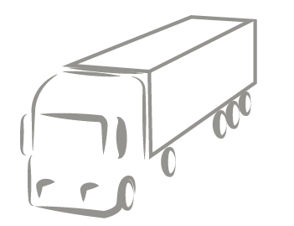
Strengths and weaknesses of road transport
Strengths
Strengths
Greater level of coverage
House-to-house transport
High average speed
Flexibility and security
High degree of capacity utilisation
Weaknesses
Limited carrying capacity
Lots of dependencies
High risk of accident
Increasing restrictions
Increasing prices
High CO2 emissions
High energy consumption
Notes:
We can assign the following strengths and weaknesses to the road transport mode:
Strengths: High speed of transport compared to rail and waterway transport modes is an advantage of road transport. The infrastructure’s coverage area, and thus the possibility of establishing networks (from door to door) is also a strength of the road. Thanks to the large number of different means of transport, the transport mode offers good flexibility. Plenty of IT solutions (e.g. Tracing and Tracking) are also widely in use already. In addition, the road transport mode achieves a high degree of capacity utilisation from the means of transport.
Weaknesses: Since costs for traffic jams or noise pollution (so-called external costs) are being taken more and more into consideration, the road is being met with increasing cost pressure. The time restriction in the form of driving prohibitions also has an impact on the road transport mode. Furthermore, the road has more limited capacities compared to other transport modes. With respect to environmental aspects such as noise pollution, CO2 emissions, or accidents, the road comes out fairly poorly compared to other transport modes.
Source:
Cf. Kille & Schmidt, 2008, p. 53
Cf. Dolinsek et al., 2013, pp. 19 ff.

Slide 9
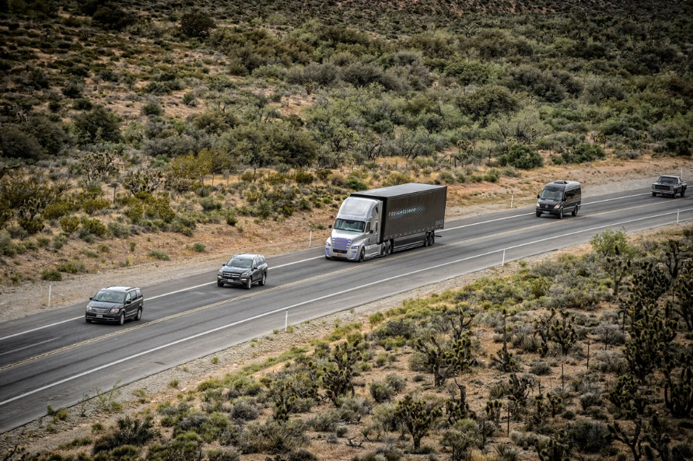
    Future prospects
    Self-driving trucks
Strengths
Increased efficiency
Increased security
Expanded job profile
Weaknesses
Characteristics:
Autopilot
Various systems
Intervention options
Legal obstacles
Legal situations differ by country
Source: Daimler Trucks (2015) online.
Notes:
Due to the multiplicity of their aspects (e.g. of a technical, natural, social, or cultural nature), transport modes are subject to constant changes. Consequently, various trends have developed within road transport, such as self-driving trucks, and platooning, amongst others.
Self-driving trucks: The concept of a self-driving truck is based on the basic function of an aeroplane’s autopilot. By activating this function, the lane, distance from other vehicles, and speed are defined and adhered to automatically using various different systems (radar sensors, stereo cameras, assistance systems, or distance regulators). However, this new concept does not replace drivers in road transport. Rather, drivers still have control over the vehicle and can decide individually when to switch the self-driving system on or off. Thus responsibility is given back to the driver in above all situations which the autopilot can no longer manage (e.g. bad weather, or narrow loading and unloading areas). If, for whatever reason, the driver does not react (even after multiple signals have been activated), automatic braking is engaged for safety reasons.
This concept has the following strengths:
Increased efficiency (around 5% fuel consumption reduction)
Increased security (e.g. reducing risk of accident)
Expanded “Truck driver” job profile (can take on new duties, e.g. dispatching)
This concept has the following weaknesses:
Legal obstacles (e.g. Vienna Convention)
Legal situations differ by country
Content sources:
Cf. APA 2015 online;
Cf. Postinett, 2015, online.
Cf. AFP 2015 online;
Cf. APA/DPA, 2015, online.
Cf. Verkehrsrundschau 2015 2:16-10:04 min.;
Cf. DPA 2015 online.
Image source: Daimler Trucks (2015) online.

Slide 10
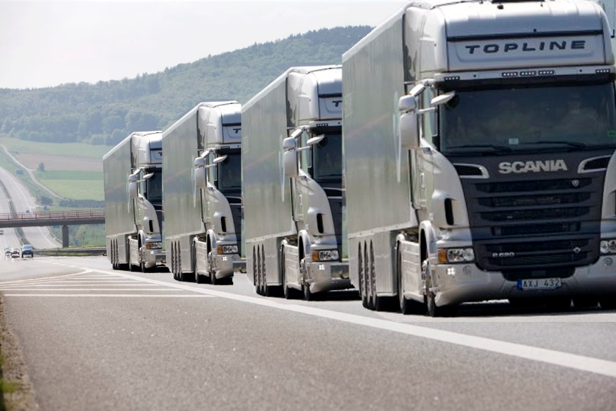
    Future prospects
    Platooning
Strengths
Better transport flow
Increased efficiency
Environmentally friendly
Characteristics:
Networked convoys
Innovative technology
Around 10 trucks per convoy
Weaknesses
Focus on the road
Legal obstacles
Legal situations differ by country
Source: RSGB Limited (2014) online
Notes:
Platooning: The term “platooning” is from the military and means roughly “truck convoy” or “networked convoy”. “Platooning” works like a classic goods train, only that it is not train wagons but trucks that are coupled. The individual trucks are coupled using innovative technologies (WiFi, WLAN, GPS etc.) and fitted with the latest systems (e.g. automatic braking or distance regulators). The driving behaviour of the truck train is controlled by the front truck. The vehicles drive at a speed of around 80 kph (50 mph), maintaining a distance of around 5 m. The aim of the concept is that 10 trucks can form such a train and that in the long term it will be possible not only to network the trucks with each other but also with the infrastructure. The autonomous driving of trucks is an important building block in this respect.
This concept has the following strengths:
Reduced waiting times (better transport flow)
Increased efficiency (optimum capacity utilisation, reduced traffic jams, better coordination between loading and unloading)
Reduced environmental impact
This concept has the following weaknesses:
Promoting road transport and increased strain on infrastructure (due to increased freight transport in future)
Legal obstacles
Regulations differ by country
Content sources:
Cf. Bay 2016 online;
Cf. European Truck Platooning Challenge 2016a online;
Cf. Christof 2015 online;
Cf. Holzer 2016 online;
Cf. Scania Group 2013 0:00-2:12.
Image source: RSGB Limited 2014 online.

Slide 11
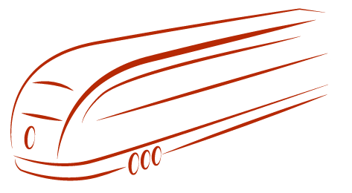
Strengths and weaknesses of rail transport
Strengths
High capacity
High security and reliability
Speed of transport
Low cost per unit
Well suited to automation
Weaknesses
High fixed cost component
Terminal-to-Terminal transport
Relatively limited flexibility
Notes:
We can assign the following strengths and weaknesses to the rail transport mode:
Strengths: Railways can achieve excellent transport speeds, especially with block trains or direct trains. Moreover, the transport mode is capable of mass transport and the transport is predictable. The level of safety is very high thanks to the standards. Unlike for the road, transport prices are not influenced by road tolls, and can therefore be relatively good value depending on the quantity being transported. A further advantage is the lower CO2 consumption compared to road transport.
Weaknesses: Due to the infrastructure differences, cross-border transport by rail is still quite tough. The flexibility of the transport is also impaired by its dependency on driving plans. Tracking and tracing is also very difficult compared to road transport. Additionally, rail transport, unlike air transport, does not offer any tax benefits.
Source:
Cf. Kille & Schmidt, 2008, p. 54

Slide 12
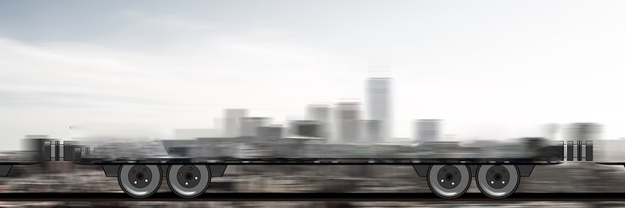
Future prospects
Developing new:
  Traction units
  Locomotives
  Goods wagons
The following aims are pursued:
  Increasing profitability
  Environmentally-friendly railway goods transport
  Reduce noise pollution
  Increase production
  Reduce transport time
We drive into the future
Notes:
Due to the multiplicity of their aspects (e.g. of a technical natural, social, or cultural nature), the rail transport mode is subject to constant changes. This includes, for example, the development of new traction units, locomotives, and goods wagons, with the aim of increasing profitability and environmental-friendliness, and reducing noise pollution from rail transport. Future issues in the rail transport mode will deal with reducing transport time and increasing productivity.
Source:
Höft, 2016, pp. 63-72

Slide 13
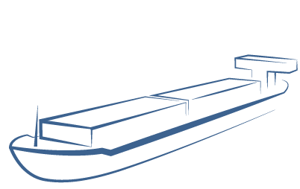
Strengths and weaknesses of waterway transport
Strengths
Strengths
High capacity
No prohibitions on transport times
High security
Affordable transport costs
Environmentally-friendly
Weaknesses
Changeable water conditions
Low speed of transport
Low network density
Terminal-to-Terminal transport
Notes:
We can assign the following strengths and weaknesses to the waterway transport mode:
Strengths: The strengths of Danube waterway transport lie above all in its ability to transport large quantities per shipping unit, its low transport costs, and its environmental-friendliness. It can also be used at all times of the day (e.g. no prohibitions on transporting over the weekend or at night), and offers good security and low infrastructure costs.
Weaknesses: Its weaknesses lie on its dependency on changeable water conditions and thee associated fluctuation of capacity utilisation of ships, the low transport speed, and the poor network density which often makes pre-haulage and end-haulage by road or rail necessary.
Source:
Cf. Dolinsek et al., 2013, p. 19.

Slide 14
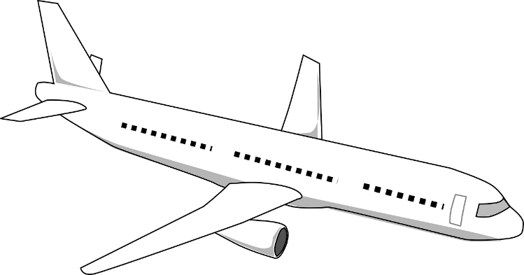
Strengths and weaknesses of air transport
Strengths
Strengths
Very fast mode of transport (from terminal to terminal)
Relatively low frequency of accidents
High reliability
Weaknesses
Very high costs
Limited transport capacity
Low network density
Terminal-to-Terminal transport
High environmental impact due to CO2 emissions

Slide 15
Further developing waterway transport
Status quo strengths
Most environmentally-friendly transport mode
Enormous capacities
Available round the clock
High security
Low transport and infrastructure costs
Future prospects - opportunities
Increasing need for environmentally-
friendly transport options
Waterways only utilised around 10-20%
Cooperation between road, rail and waterway transport
EU traffic relocation objective: transition 30% of all transport more than 300 km to railways and waterways by 2030 (50% by 2050)
Notes:
The strengths of the waterway include its status as the most environmentally-friendly transport mode, enormous capacities, high level of safety, availability around the clock, and low transport and infrastructure costs. The opportunities offered by waterways include increased significance of environmentally-friendly transport possibilities and free capacities, and the aim of the EU to transition 30% of all transport over 300 km to railways and waterways by 2030. A further opportunity is posed by the EU-wide introduction of multi-modal transport concepts in order to resolve the issue of lack of waterway infrastructure by means of cooperation between road, rail and waterway, thus increasing the significance of the waterway.
When comparing the strengths and opportunities of the waterway, it is clear that waterways will become more significant in the future.
Source:
Cf. Dalziel., 2013
Cf. Dolinsek, et al., 2013, pp.17 ff., 152 ff.
https://www.acea.be/uploads/publications/SAG_17.pdf p.7
Jahresbericht viadonau (http://www.rewway.at/de/lehrmittel/jahresbericht-donauschifffahrt-osterreich-2014) pp. 18-19.

Slide 16
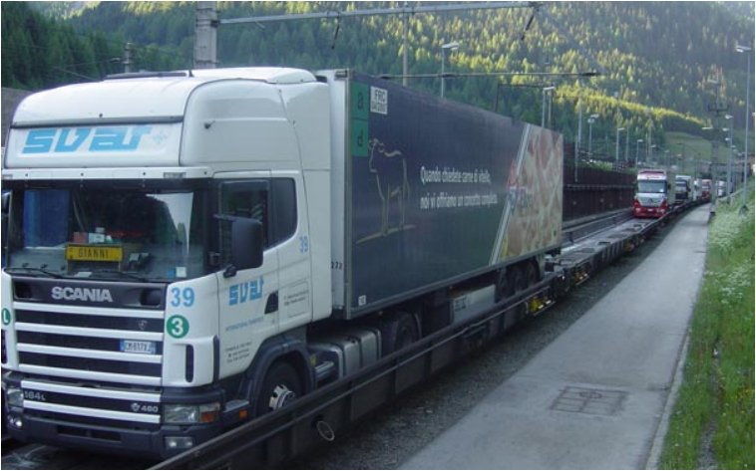
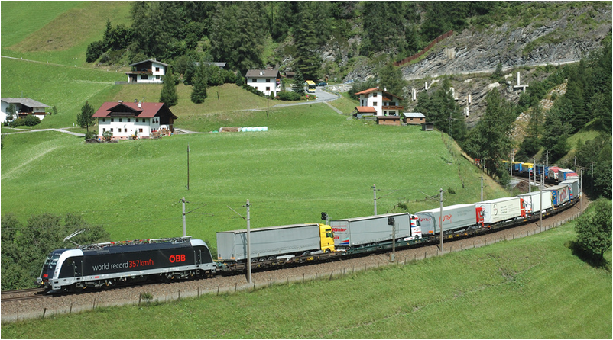
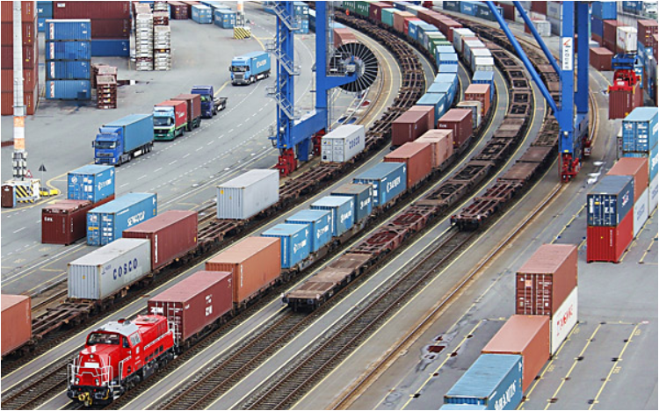
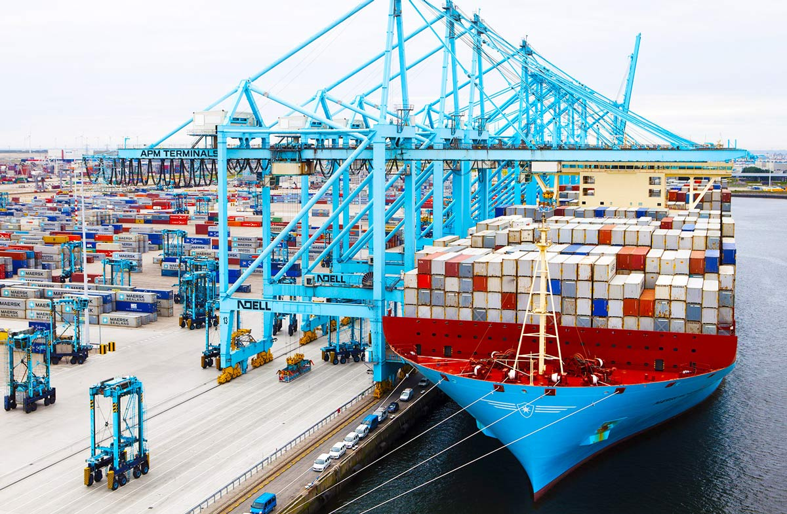
Multi-modal transport
Notes:
Intermodal transport, as a special form of multi-modal transport, is characterised by transport chains, whereby standardised loading units, e.g. containers, swap bodies, trucks, or truck trailers, are transported using different transport modes one after the other. When changing the transport mode at terminals, only the loading units are reloaded, i.e. the goods remain in the same container during the entire transport process.
The loading units (e.g. containers, swap bodies) are generally transported individually between the place of dispatch and the transshipment point (pre-haulage), and between the transshipment point and the destination (end-haulage). Main-haulage means the section between the transshipment points (e.g. transshipment terminals).
A primary characteristic of combined transport is that main-haulage is performed using environmentally-friendly means of transport, e.g. by railways but also inland/maritime vessel, whilst pre-haulage and end-haulage on the road is kept to a minimum.
By combining the transport modes, the specific advantages of the individual modes can be exploited and disadvantages of these minimized.
Due to the high network density and the speed of short transport distances, road transport is particularly suitable for the pre- and post-carriage of multimodal transports. Due to the low environmental impact and the relatively low transport costs of rail and waterway for medium and long distances and high volumes, these two transport modes are suitable for the main run in multimodal transport. By bundling freight transports, approproate transport volumes can be achieved that justify transport with these transport modes from an economic point of view.
Multi-modal transport may be more advantageous than unimodal for various reasons.
For example, in many cases unimodal transport is not possible for geographical reasons, or there may be insufficient truck capacities. In practice, the most significant reason for choosing a specific transport option is of course the financial aspect - which is the most cost-effective transport option? Given the many actors involved and the required transshipment processes, organising multi-modal transport is of course much more complicated and requires greater planning. Therefore, guaranteeing profitability compared to transport by truck is often tricky, and is generally only achieved on longer transport routes. For short distances, therefore, multi-modal transport is generally not competitive.
The following factors are essential for designing profitable multi-modal transport:
Designing efficient transshipment processes
Reducing costs for pre-haulage and end-haulage
Bundling during main-haulage to compensate for additional costs
Offering additional services
Source:
Cf. Kummer 2010 p. 57;
Becker 2014, pp. 39 f.;
Forschungsinformationssystem 2016b, online.
Image sources: Rail Cargo 2017, online;
Verkehrsrundschau 2013, online;
Verkehrsrundschau.de 2014, online.
Verkehrsrundschau.de 2015, online.

Slide 17
Agenda
Case Study
Sustainability in transport and SCM
Modal Split and Modal Shift
Transport modes
Freight transport in general

Slide 18
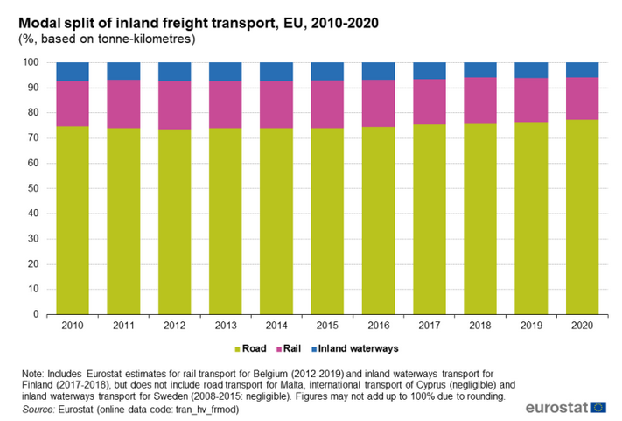
Modal Split of Inland Freight Transport EU
Notes:
The share of rail in the inland transport performance reached a low point in 2020 (16.8 %) after a drop of 0.9 pp compared to 2019. Over the period 2010-2020, the share of rail reached 19.2 % in 2011 after an increase by 1.2 pp compared to 2010. It remained stable in 2012 (19.1 %). In 2013, a drop by 0.4 pp was observed compared to the previous year. Between 2013 and 2016, the share of rail remained relatively stable (between 18.7 % and 18.8 %). In 2017, it decreased by 0.7 pp but rebounded by 0.5 pp in 2018. In 2019, rail transport accounted for 17.7 % of the EU total, decreasing by 0.9 pp compared to the previous year.
The share of inland waterways in inland freight transport performance slightly decreased in 2020 (5.8 %) compared to 2019 (-0.2 pp), reaching the same low point as observed in 2018. This low point was reached in 2018 after a constant fall since 2014. In 2010, 2012 and 2013, a peak was reached at 7.4 %.
Source: https://ec.europa.eu/eurostat/statistics-explained/index.php?title=Freight_transport_statistics_-_modal_split#Modal_split_in_the_EU

Slide 19
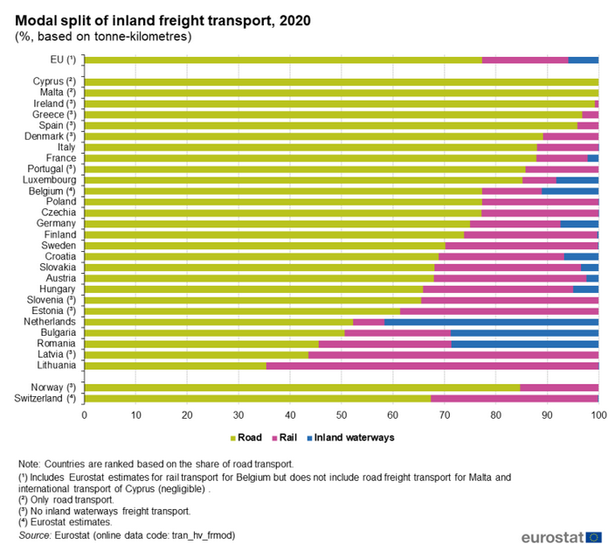
Modal Split of Inland Freight Transport EU
Notes:
Noticeable changes in the modal split of Estonia, Latvia and Slovakia from 2010 to 2020
Even though the modal split between the different modes of transport does not tend to change radically from year to year at EU level, changes are sometimes more noticeable at country level. As it can be seen in Figure 2, the modal split at country level varies considerably. In particular, the modal split obviously depends on the availability of a given mode. In particular, Cyprus and Malta do not have either railways or navigable inland waterways; thus, for these two Member States the share of road freight transport is 100 % by default. Moreover, only 17 of the Member States report freight data on inland waterways.
Source: https://ec.europa.eu/eurostat/statistics-explained/index.php?title=Freight_transport_statistics_-_modal_split#Modal_split_in_the_EU

Slide 20
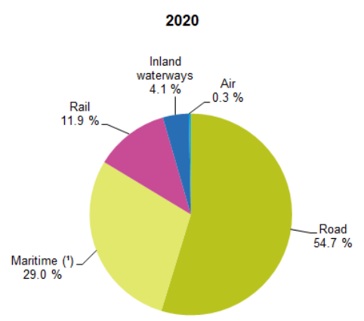
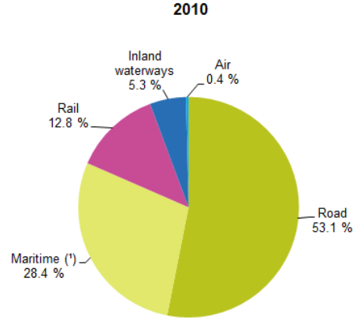
Modal Split of Freight Transport EU
Notes:
Figure 6 shows the modal split calculated on the basis of transport performance, measured in tonne-kilometres, of five transport modes: road, rail, inland waterways, air and maritime. When adding air and maritime transport to the inland modes, road still keeps its leading position at the intra-EU level, followed by maritime transport. In 2020, road accounted for more than half of all tonne-kilometres performed in the EU (54.7 %). Maritime transport came next, with less than a third of the total transport performance (29.0 %), followed by rail (11.9 %) and inland waterways (4.1 %). In terms of tonne-kilometres performed, air transport plays only a marginal role in intra-EU freight transport, with a share of 0.3 % in 2020.
In 2020 compared to the previous year, the relative shares of maritime, rail and inland waterways transport decreased by 0.7 pp, 0.5 pp and 0.1 pp, respectively, whereas the share of road transport increased by 1.3 pp and the share of air transport remained stable (-0.03 pp). When looking at the period 2010-2020, inland waterways and rail transport decreased by 1.2 pp and 0.9 pp, respectively, while the share of road and maritime transport increased by 1.6 pp and 0.5 pp respectively. The share of air transport remained relatively stable (-0.05 pp).
Source: https://ec.europa.eu/eurostat/statistics-explained/index.php?title=Freight_transport_statistics_-_modal_split

Slide 21
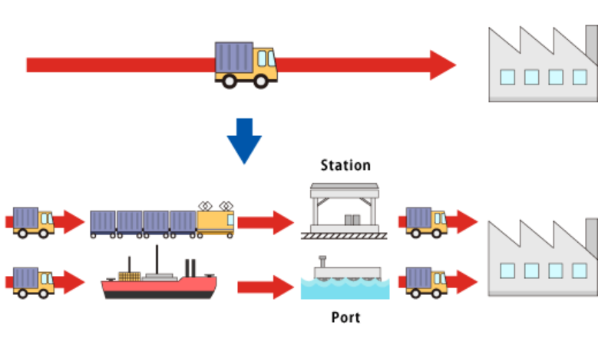
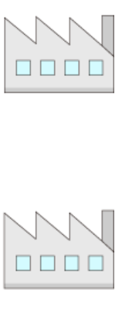
Modal Shift
Source: https://www.mitsubishi-logistics.co.jp/english/service/pd/subject/modalshift.html

Slide 22
Agenda
Case Study
Sustainability in transport and SCM
Modal Split and Modal Shift
Transport modes
Freight transport in general

Slide 23
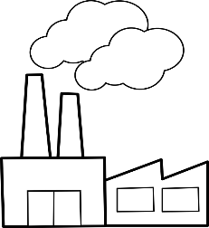
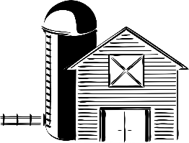



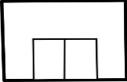


What is a supply chain?
Flow of a good from the raw components to delivering the final product to the consumer
Source
Make
Deliver
Source
Make
Deliver
Source
Make
Deliver
Supplier
(Farm)
Manufacturer
(Dairy)
Customer
(Supermarket)
Information and money also flow in a supply chain.
In practice there are often not just simple chains, but rather complex supply networks.

Slide 24



What is sustainability?
Meeting the needs of the present without compromising the ability of future generations to meet their own needs (United Nations)
Ensuring a balance between social well-being, environmental care and economic activities
Sustainability
Social
Environ-
mental
Economic

Slide 25

What makes a supply chain sustainable?
Some possible approaches
Source
Make
Deliver
Ensure fair treatment of suppliers’ labor
Good working conditions
Responsible selection of target markets and groups
Fair wages
Ensure protection of natural environment by suppliers
Green product design
Green production technologies
Sustainable transport
Green production and warehousing facilities
Green packaging
Fair treatment of suppliers
Business strategy aiming for long-term success instead of short-term profits
Fair treatment of customers

Slide 26

Sustainable transport
Avoid unnecessary transports (e.g. local procurement and selling)
Prefer environmentally friendly modes of transport (e.g. rail)
Avoid low utilization of vehicles (i.e. avoid partly empty vehicles)
Optimize routes
Use environmentally friendly modes of drive (e.g. electric vehicles)

Slide 27
Agenda
Case Study
Sustainability in transport and SCM
Modal Split and Modal Shift
Transport modes
Freight transport in general

Slide 28
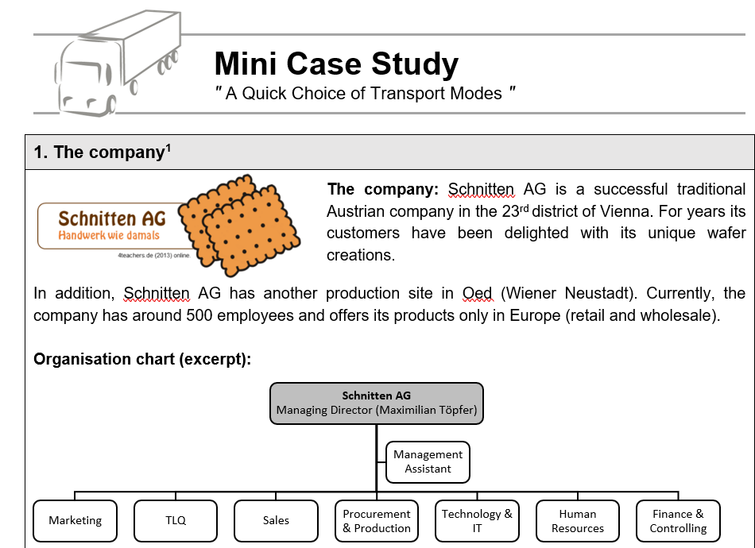
Case Study
  Form mixed groups of 4-5 persons each
  Solve the 3 tasks
  Each task is presented by a different group (drawing of lots) – PowerPoint or Flip chart
  Ask questions if something is unclear
  Preparation time: 30 min.

Slide 29
Case Study Sample Solution
Task 1
Question 1: What is the central problem facing the production department of Schnitten AG?
The dosing head of the Alpha production machine (important for cookie production) is defective. The necessary spare part is only available in Bucharest, is decisive for the continuation of production and needs to be collected by Schnitten AG.

Slide 30
Case Study Sample Solution
Task 1
Question 2: What information does your supervisor need to take into account when designing transport planning?
Transport route: Bucharest to Vienna
Weight: the spare part weighs less than 5 kg
Spare part is vital for the continuation of production
Projected rising sales figures in the coming weeks (loss of production would lead to loss of customers; possible penalty payments due to binding agreements, company image may suffer)
Sustainability project and sustainable orientation of the company (less important for management)
Inventory coverage: less than 5 days, meaning very low warehouse stock, not even enough for one week. Info: Inventory coverage provides information on internal security of supply through your own stocks within a certain period. It thus indicates the time factor for which the warehouse stock remains safe at average or planned material consumption.

Slide 31
Case Study Sample Solution
Task 2
According to management, the two criteria "speed" and "safety" are equal and weigh more than the criterion "environmental friendliness". No specific specifications are given for the criterion "spare parts affinity".
The following scenarios, among others, can be conceived for the weighting:
 | Speed | Safety | Spare parts affinity | Environmental friendliness
Scenario 1 | 40% | 40% | 10% | 10%
Scenario 2 | 35% | 35% | 20% | 10%
Scenario 3 | 45% | 45% | 15% | 5%
Scenario 4 | 30% | 30% | 10% | 30%

Slide 32
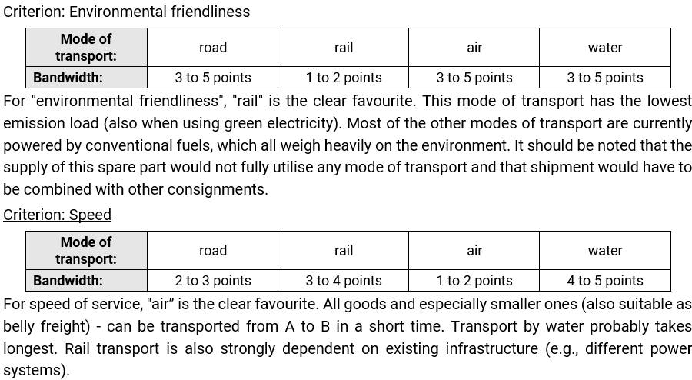
Case Study Sample Solution
Task 2

Slide 33
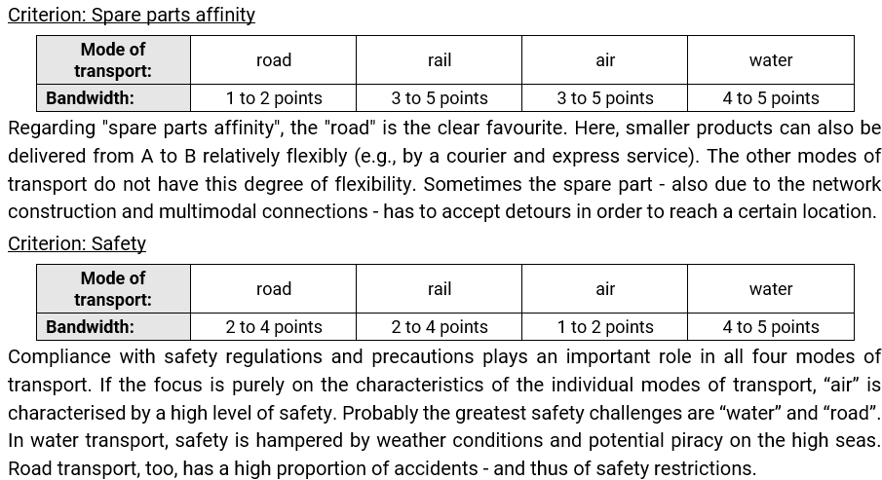
Case Study Sample Solution
Task 2

Slide 34
Case Study Sample Solution
Task 2
Conclusive assessment
Urgency (= acute problem, otherwise the production of cookies can no longer be continued, and projected sales are at risk) and the transport good (= small without high weight and size requirements), makes the two modes of transport "road" and "air" basically suitable for Schnitten AG. When using air transport, including a means of transport by road is desirable, as Schnitten AG is not located directly at Vienna Airport.

Slide 35
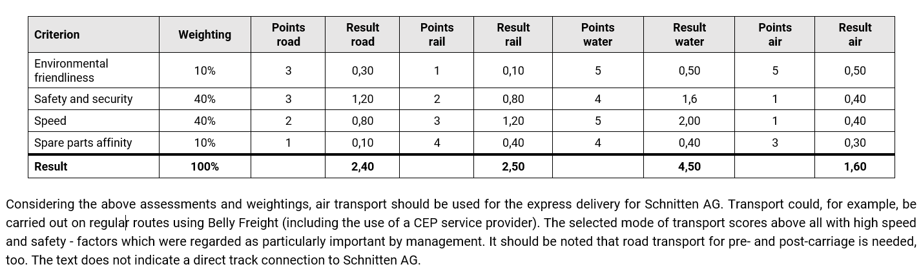
Case Study Sample Solution
Task 2 Possible Scoring Table

Slide 36
Case Study Sample Solution
Task 3
Producer packaging material
Supermarket
chain 1
Farmer for agricultural produce 1
Schnitten AG
Supermarket
chain 2
Farmer for agricultural produce 2
Organic and vegan ingredients
Good working conditions and fair wages
Sustainable business model
Supermarket
chain 3
Farmer for agricultural produce 3
Reduced weight and volume of packaging
Optimization of routes and vehicle utilization when delivering to supermarkets
Electric vehicles for delivery to supermarkets
Local suppliers to reduce transports
Rail and sea for transporting raw materials
Certification of suppliers to ensure social and environmental standards
No inadequate economic pressure on suppliers

Slide 37
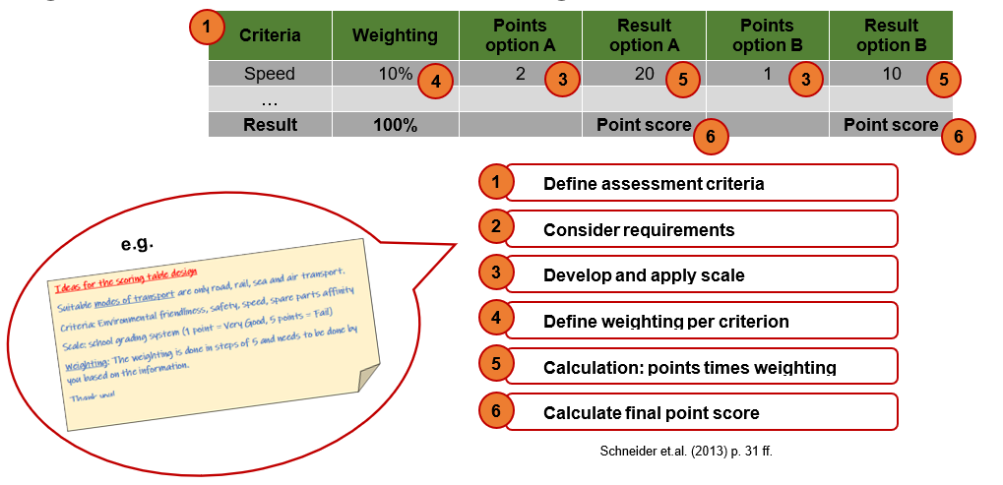
Appendix
Scoring method

