Slide 1
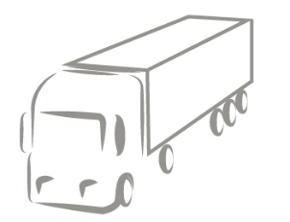

Trends and Innovations
in Logistics

Slide 2
Agenda
Overview trends and innovations in logistics
Discussion of results
Exercise
Introduction to trends and innovations

Slide 3




Megatrends in Logistics
Megatrends are defined as are long-term driving forces that are observable now and will most likely have significant influence on the future. They transformed the logistics industry over the past decades and will continue to do so in the future.
Globalisation
E-commerce
Digitalisation
Sustainability
Source: https://knowledge4policy.ec.europa.eu/foresight/tool/megatrends-hub_en; https://www.dhl.com/global-en/home/insights-and-innovation/insights/logistics-trend-radar.html

Slide 4
Macro Forces as Drivers of Change
Macro Forces influence the growth and importance of trends. They compound or conflict with one another.
societal values
demographics
climate change
the Covid-19 pandemic
urbanization
consumer behavior
geopolitical events
labor shortages
…
Source: https://www.dhl.com/global-en/home/insights-and-innovation/insights/logistics-trend-radar.html

Slide 5
What are innovations?
Innovations are novel combinations of new or existing knowledge, resources, equipment, and other factors with the intent of commercialization. They enable companies to face the future.
Two types of companies (Schumpeter, 1934):
  Innovators aim to replace the old with something new: they want to create the innovation that enables them to be the only ones who can offer or do something for a certain period.
  Arbitrage companies try to exploit price differences for their own profit. They want to buy as cheaply as possible and sell as expensively as possible, but do not create anything new in the process.
Source: https://www.schoolgames.eu/components/com_jobprofiles/files/media/20.pdf, https://link.springer.com/chapter/10.1007/978-981-10-0983-9_56
Notes:
The Austrian economist Joseph Schumpeter is regarded as one of the greatest economists of the first half of the twentieth century.
His concepts of innovation and entrepreneurship are still of great importance today.
In 1934, Schumpeter added a definition of “innovation,” or “development,”
as “new combinations” of new or existing knowledge, resources, equipment,
and other factors. He pointed out that innovation needs to be distinguished from
invention. The reason why Schumpeter stressed this difference is that he saw
innovation as a specific social activity, or “function,” carried out within the eco-
nomic sphere and with a commercial purpose, while inventions in principle can
be carried out everywhere and without any intent of commercialization. Thus,
for Schumpeter, innovations are novel combinations of knowledge, resources,
etc. subject to attempts at commercialization—it is essentially the process
through which new ideas are generated and put into commercial practice.

Slide 6
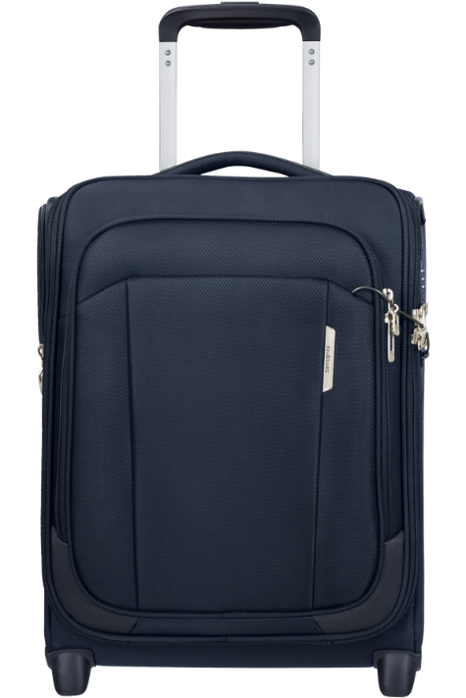
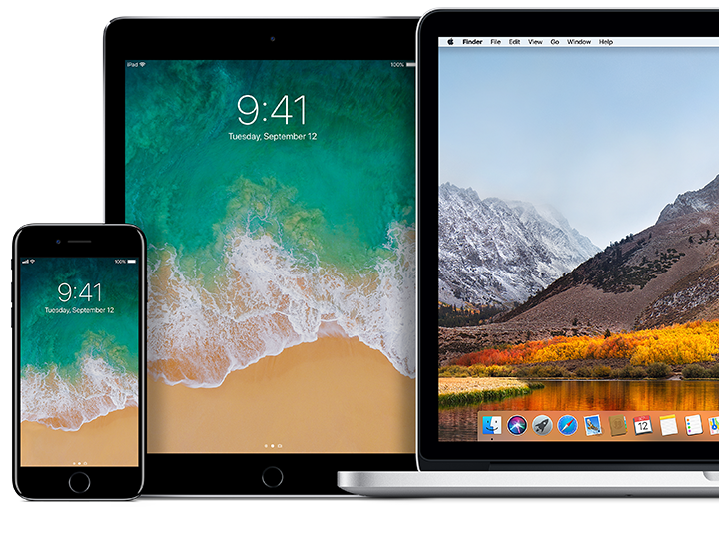
Product innovations
Product innovation means creating a new product – or substantially improving an existing one - to meet customers’ needs in a novel way.
Source: https://www.green-salamander.de/innovationstypen-was-ist-neu/; https://online.hbs.edu/blog/post/product-innovation; https://www.apple.com/de/shop/browse/finance/loan; https://www.samsonite.at/respark-upright-45-16-underseater--midnight-blue/143311-1549.html?cgid=luggage_new-arrivals
Notes:
Apple is the largest technology company by revenue, founded 1976 as producer of personal computers -
iPods (2001), des iPhones (2007), des iPads (2010) und der Apple Watch (2014)
Rollaboard: 1987

Slide 7
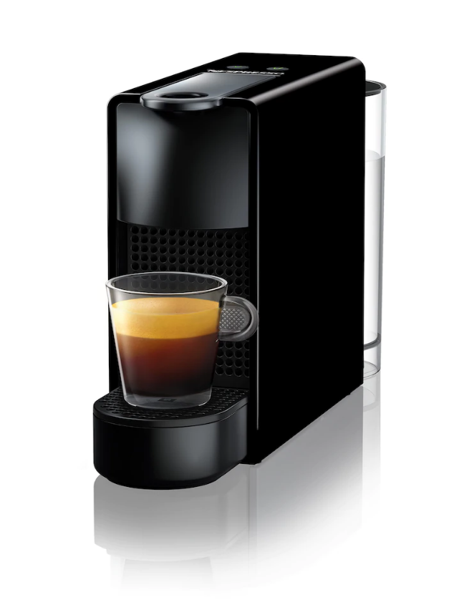
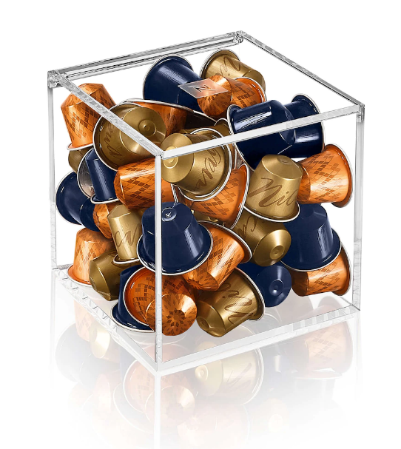
Process innovations
Process innovation means making the same good or service simpler, faster or cheaper through improved "innovative" processes, or in producing a better-quality product at the same price.
Source: https://www.green-salamander.de/innovationstypen-was-ist-neu/; https://www.schoolgames.eu/components/com_jobprofiles/files/media/20.pdf; https://www.nespresso.com/at/de/;

Slide 8
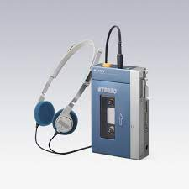
Market innovations
Market innovation means the opening up of new markets, changing existing market structure, introducing new market devices, altering market behavior, and generally changing the way in which business is done.
Source: https://www.green-salamander.de/innovationstypen-was-ist-neu; https://www.theverge.com/2014/7/1/5861062/sony-walkman-at-35; https://www.sciencedirect.com/science/article/pii/S0148296320306378
Notes:
In1979, Sony launched its first Walkman. Sony invented the market for mobile music.

Slide 9


Organisational innovations
Organisational innovation can be defined as the introduction of something new (an idea, product, service, technology, process, and strategy) to an organization.
Source: https://innovationcloud.com/blog/where-to-innovate-organizational-innovation-explained.html; https://link.springer.com/chapter/10.1007/978-981-10-0983-9_56
Notes:
In1979, Sony launched its first Walkman. Sony invented the market for mobile music.

Slide 10

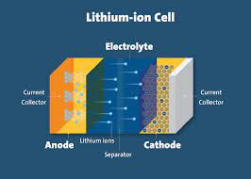
Input innovations
Input innovations are based on the use of new materials, forms of energy, components, property rights or new knowledge.
Source.https://link.springer.com/chapter/10.1007/978-981-10-0983-9_56; https://www.green-salamander.de/innovationstypen-was-ist-neu/; https://www.spiegel.de/panorama/gesellschaft/vietnam-oeffnet-wohl-laengste-glasbruecke-der-welt-tief-ins-glas-schauen-a-ccf0b37e-f919-4360-ad3b-79a6a84aaced; https://ul.org/research/electrochemical-safety/getting-started-electrochemical-safety/what-are-lithium-ion
Notes:
Lithium-ion batteries: Smart phones
tempered glass: glass-bottom bridges

Slide 11

Exercise - Aims
We identify and analyze innovations in logistics.
Discover various innovations in logistics
Train how to gather and evaluate information
Work in teams and utilize diverse backgrounds

Slide 12
Exercise - Steps
① Identify
② Analyze
③ Report
Identify innovations in logistics.
As innovation consider a product or solution that is relatively new and/or is related to relatively new trends and challenges.
Analyze how relevant each innovation is.
As an indicator for an innovation’s relevance consider how much attention it gets. An innovation should be considered as highly relevant, when the level of attention is high and this level is increasing over time.
Report the results in a structured way.
Use this framework to structure the innovations:
high
Level of attention
decreasing
increasing
low

Slide 13
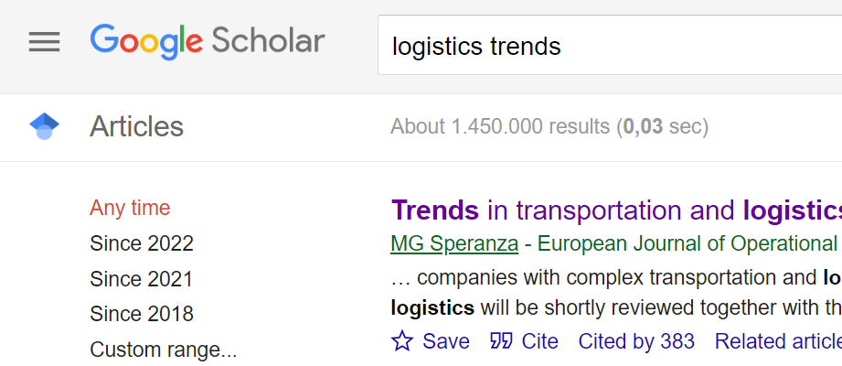
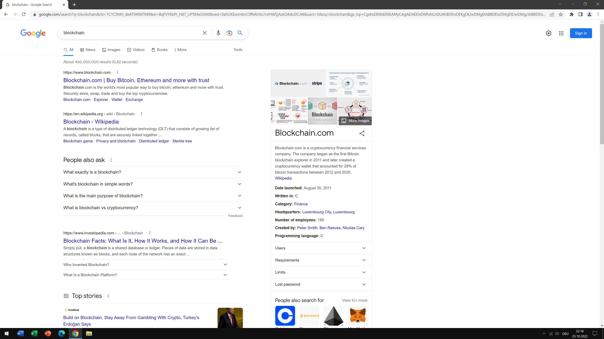

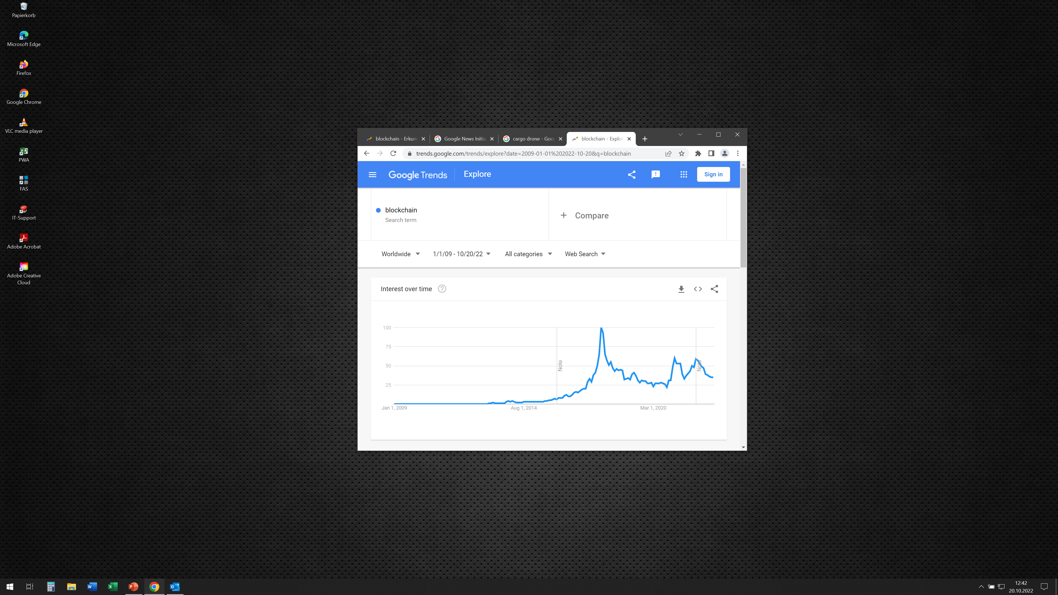

Exercise - Tools
① Identify
② Analyze
③ Report
Identify innovations in logistics.
Analyze how relevant each innovation is.
Report the results in a structured way.
Google Scholar
Google Search
Microsoft Excel
Google Trends
Group’s expertise

Slide 14
Exercise - Schedule
① Identify – ② Analyze – ③ Report
Group work
50 minutes
Discussion of results
All together
15 minutes

Slide 15
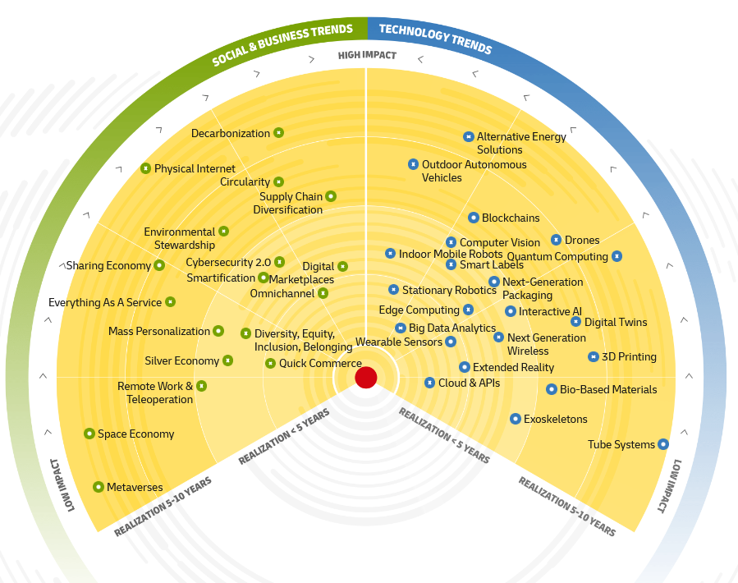
Trends and Innovations in Logistics
DHL Trend Radar (2022)
Source: https://www.dhl.com/global-en/home/insights-and-innovation/insights/logistics-trend-radar.html?cid=organic-email_Kuthma&j=611846&sfmc_sub=286387503&l=59_HTML&u=34543965&mid=7275327&jb=27004

